Slide 1
Testing screen shot presentation

Slide 2
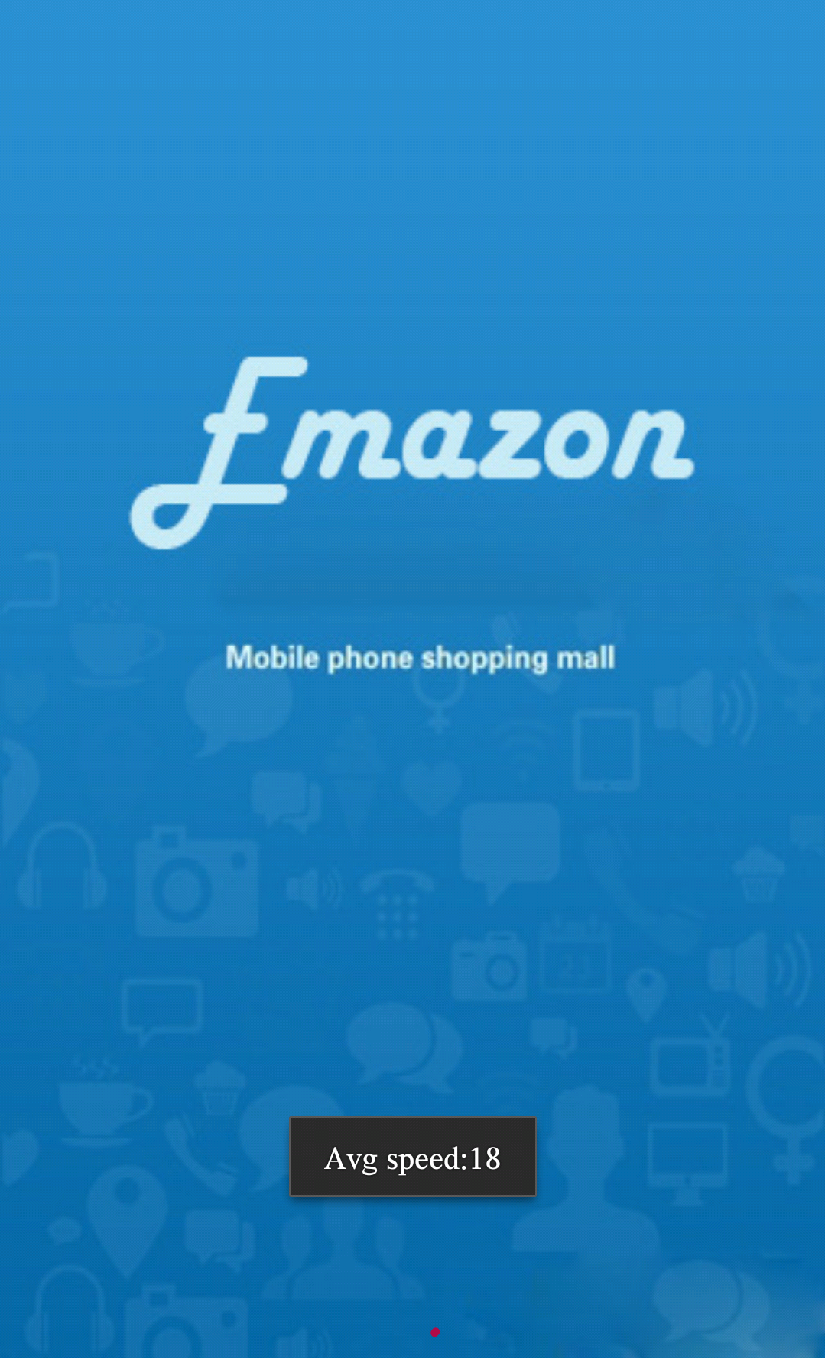
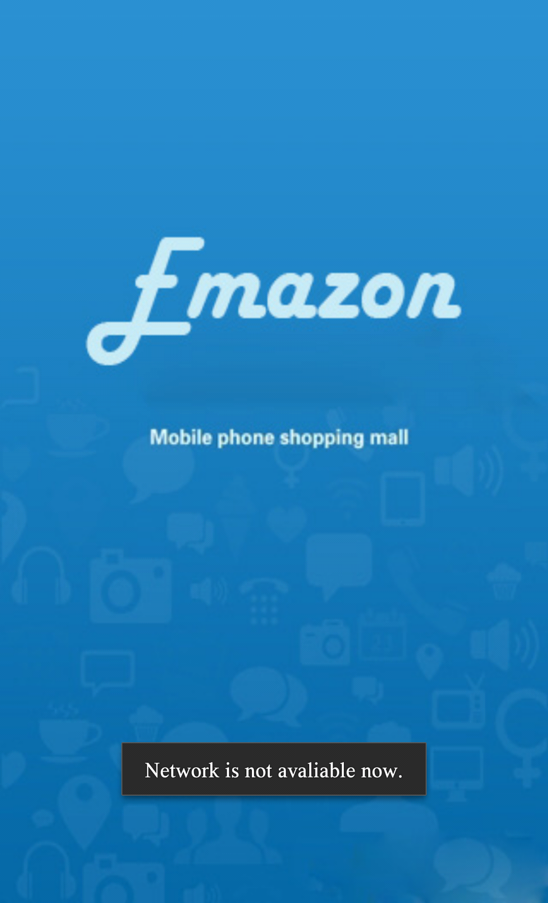
The network tesing starts when the app is opening. If the network is not avaliable, the task will not be conducted
Network avaliable
Network not avaliable

Slide 3
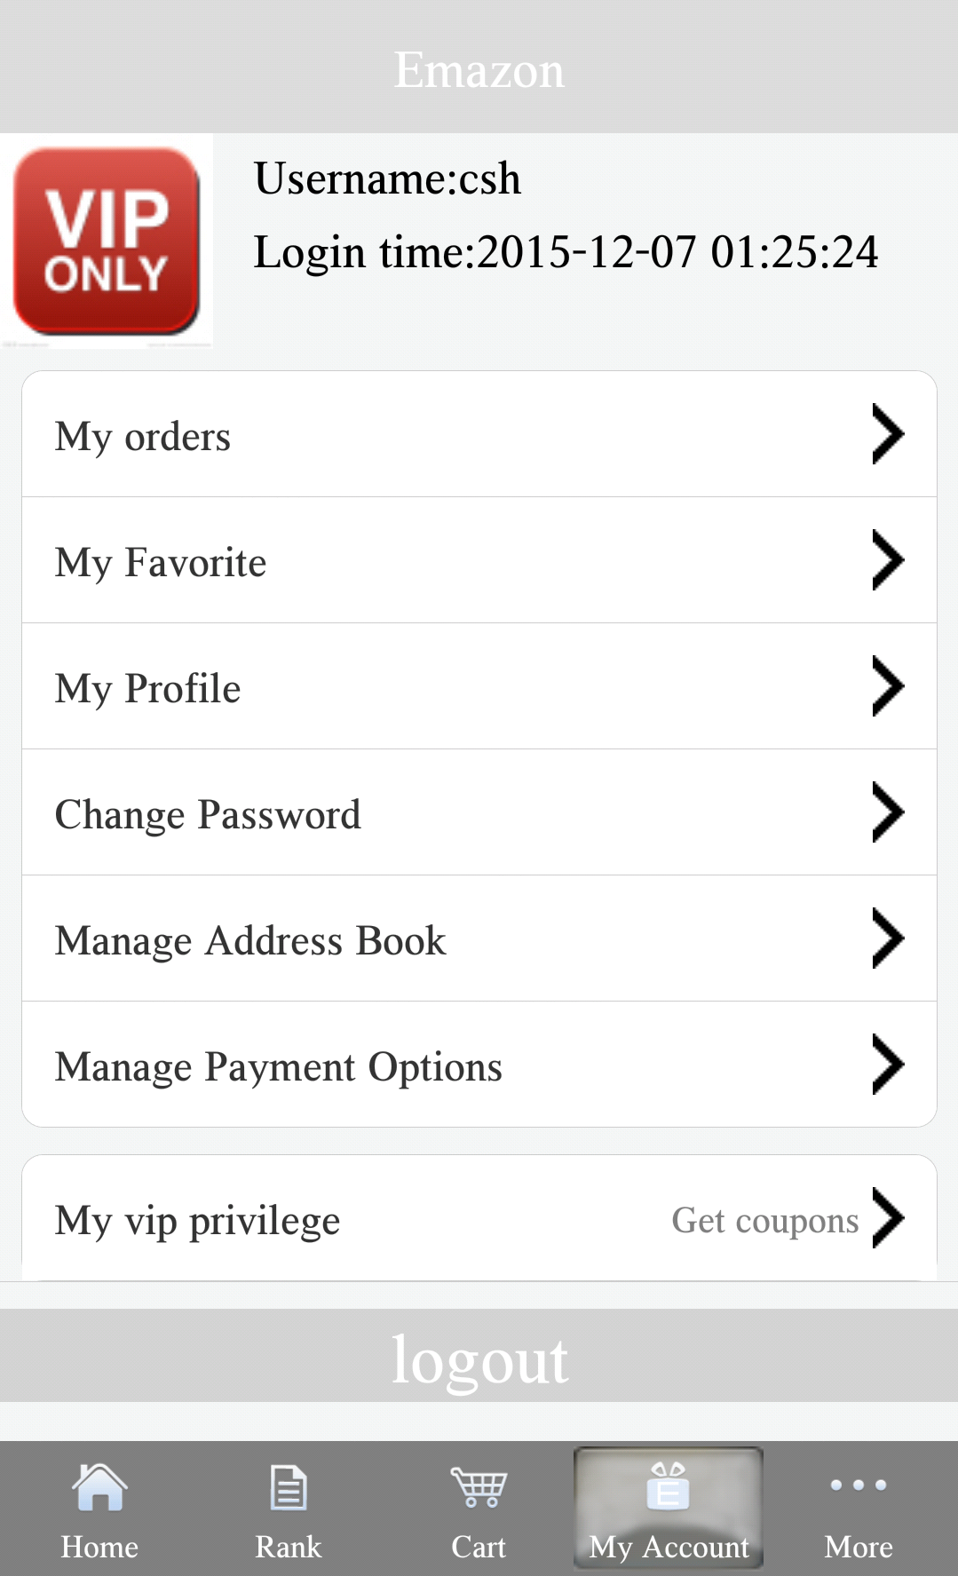
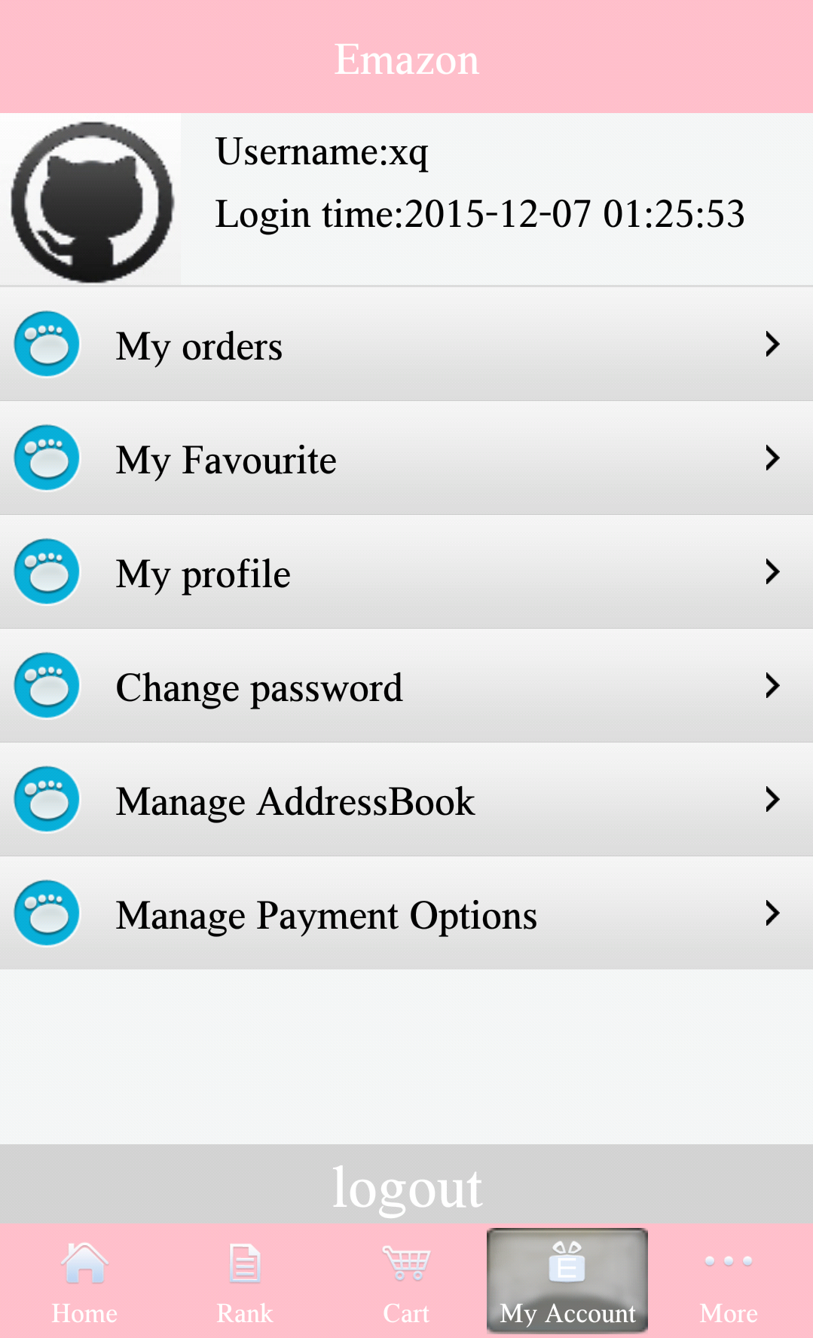
VIP and non VIP user account page
VIP user:
VIP logo
VIP privilege
Better user interface(latest UI style)

Slide 4
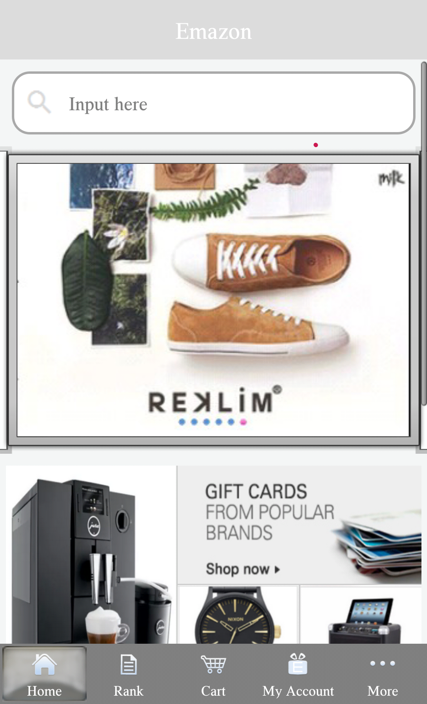
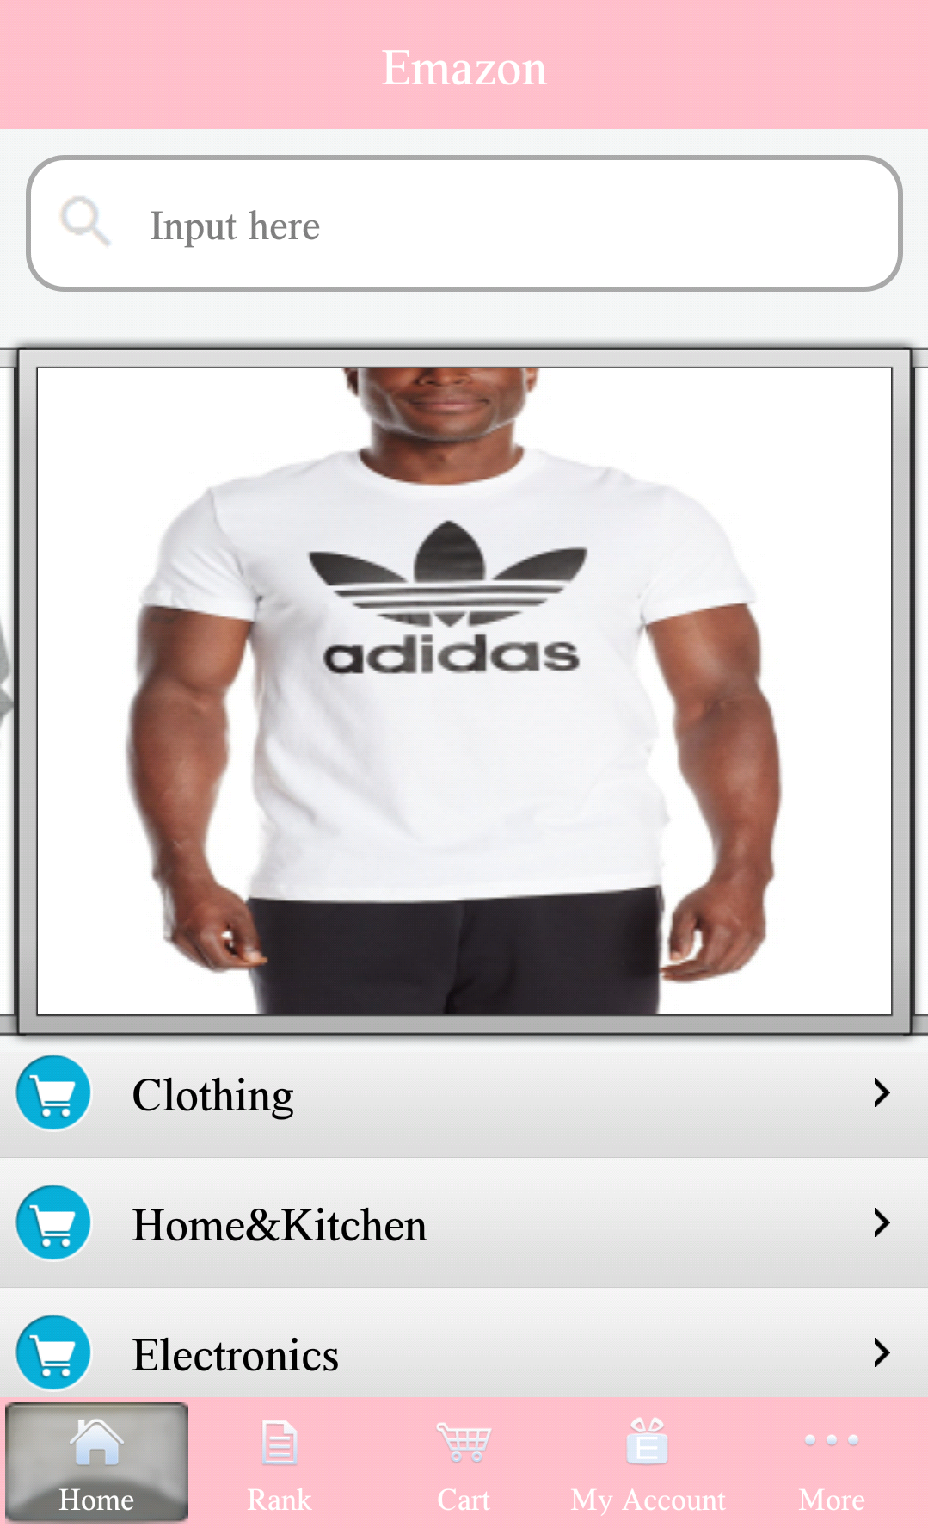
VIP and non VIP user home page
VIP user:
Picture style
Non VIP user:
Product classification only

Slide 5
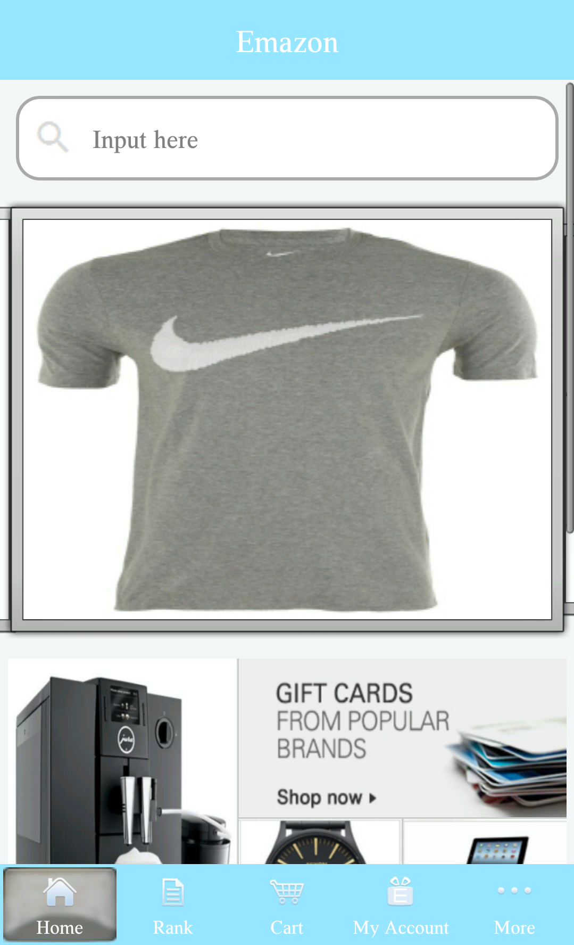
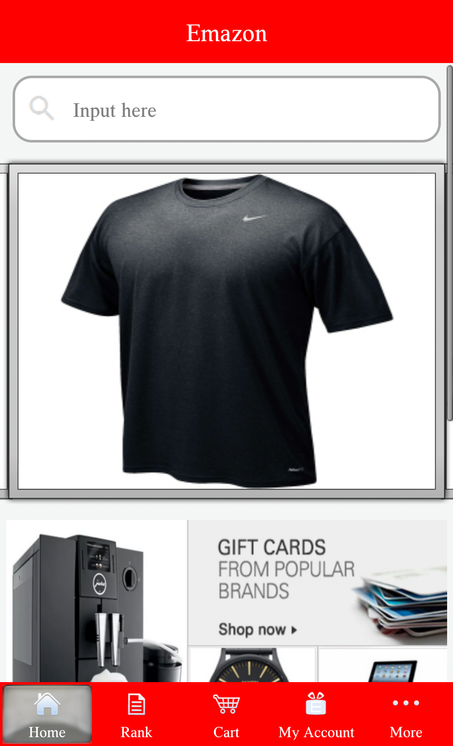
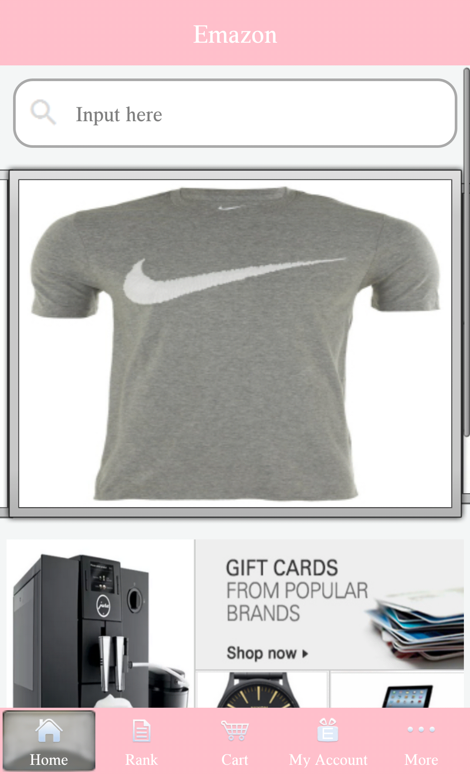
VIP and non VIP user theme
For all user, the default theme(male is Gray, female is Pink).
VIP user can change app theme, the options are: Blue, Red or others.
Non VIP user can't change the theme.

Slide 6
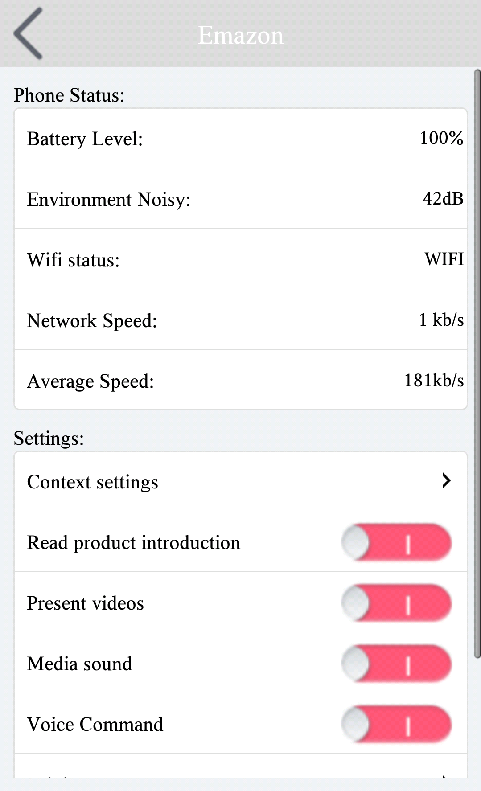
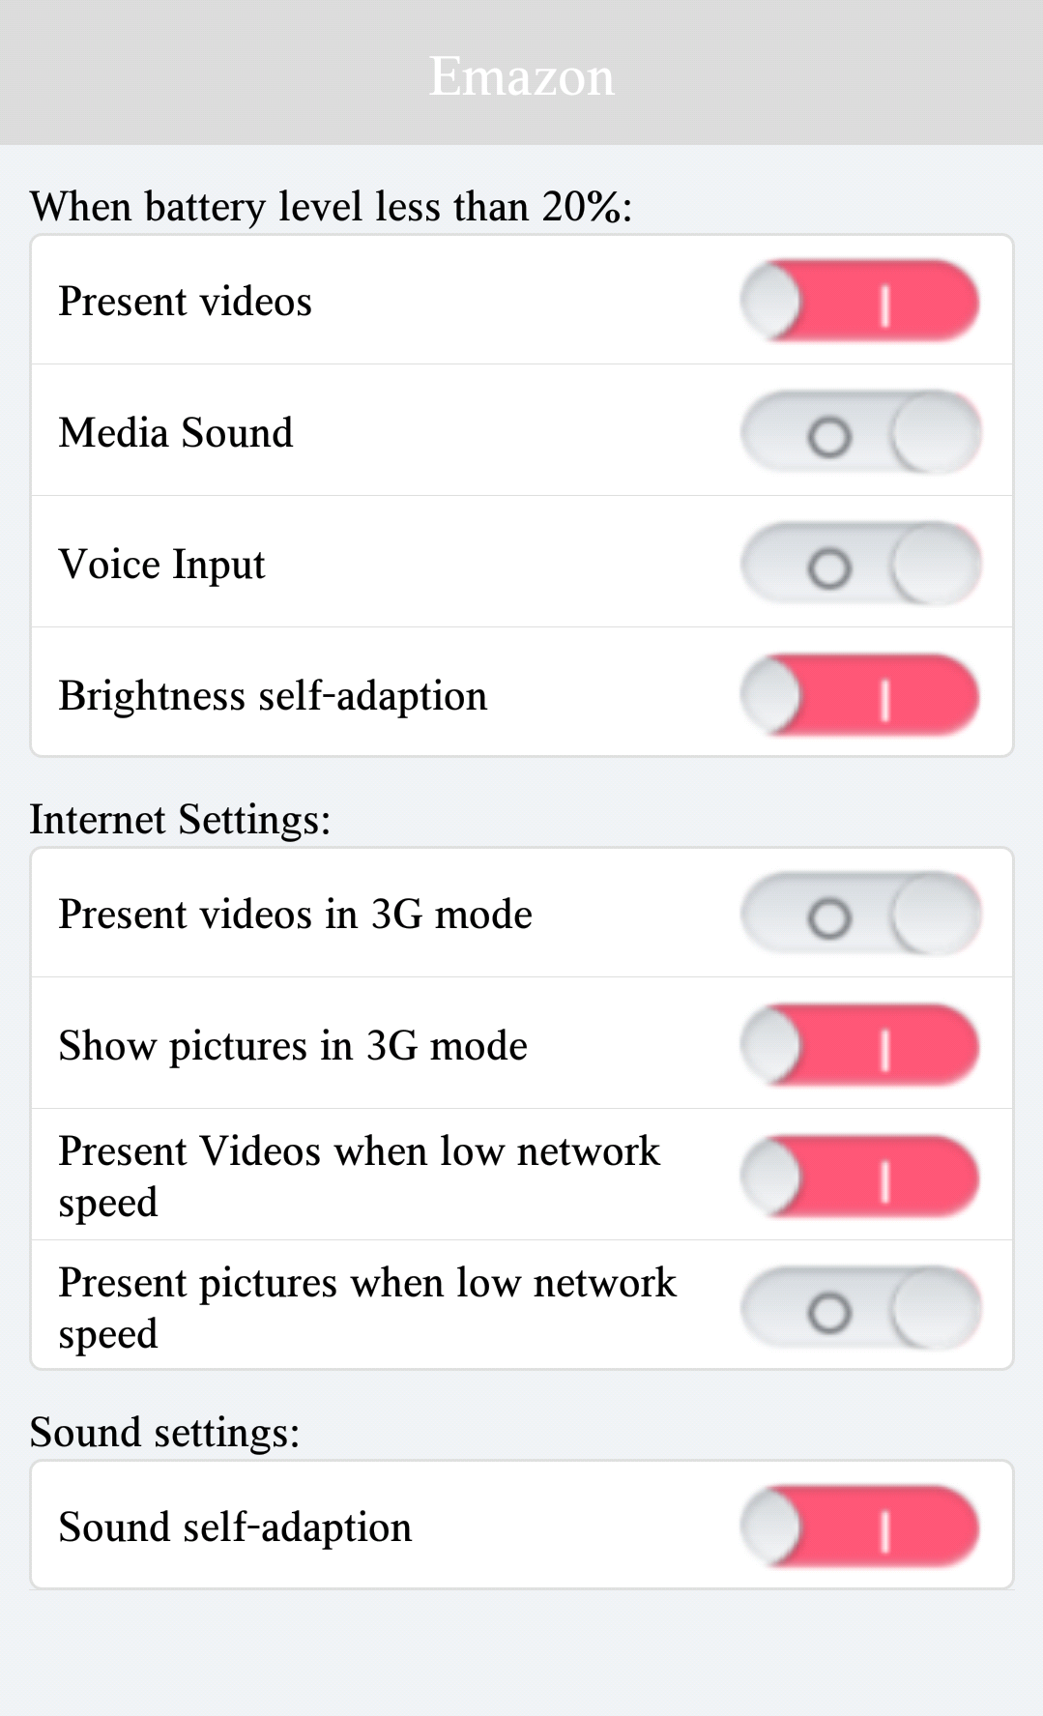
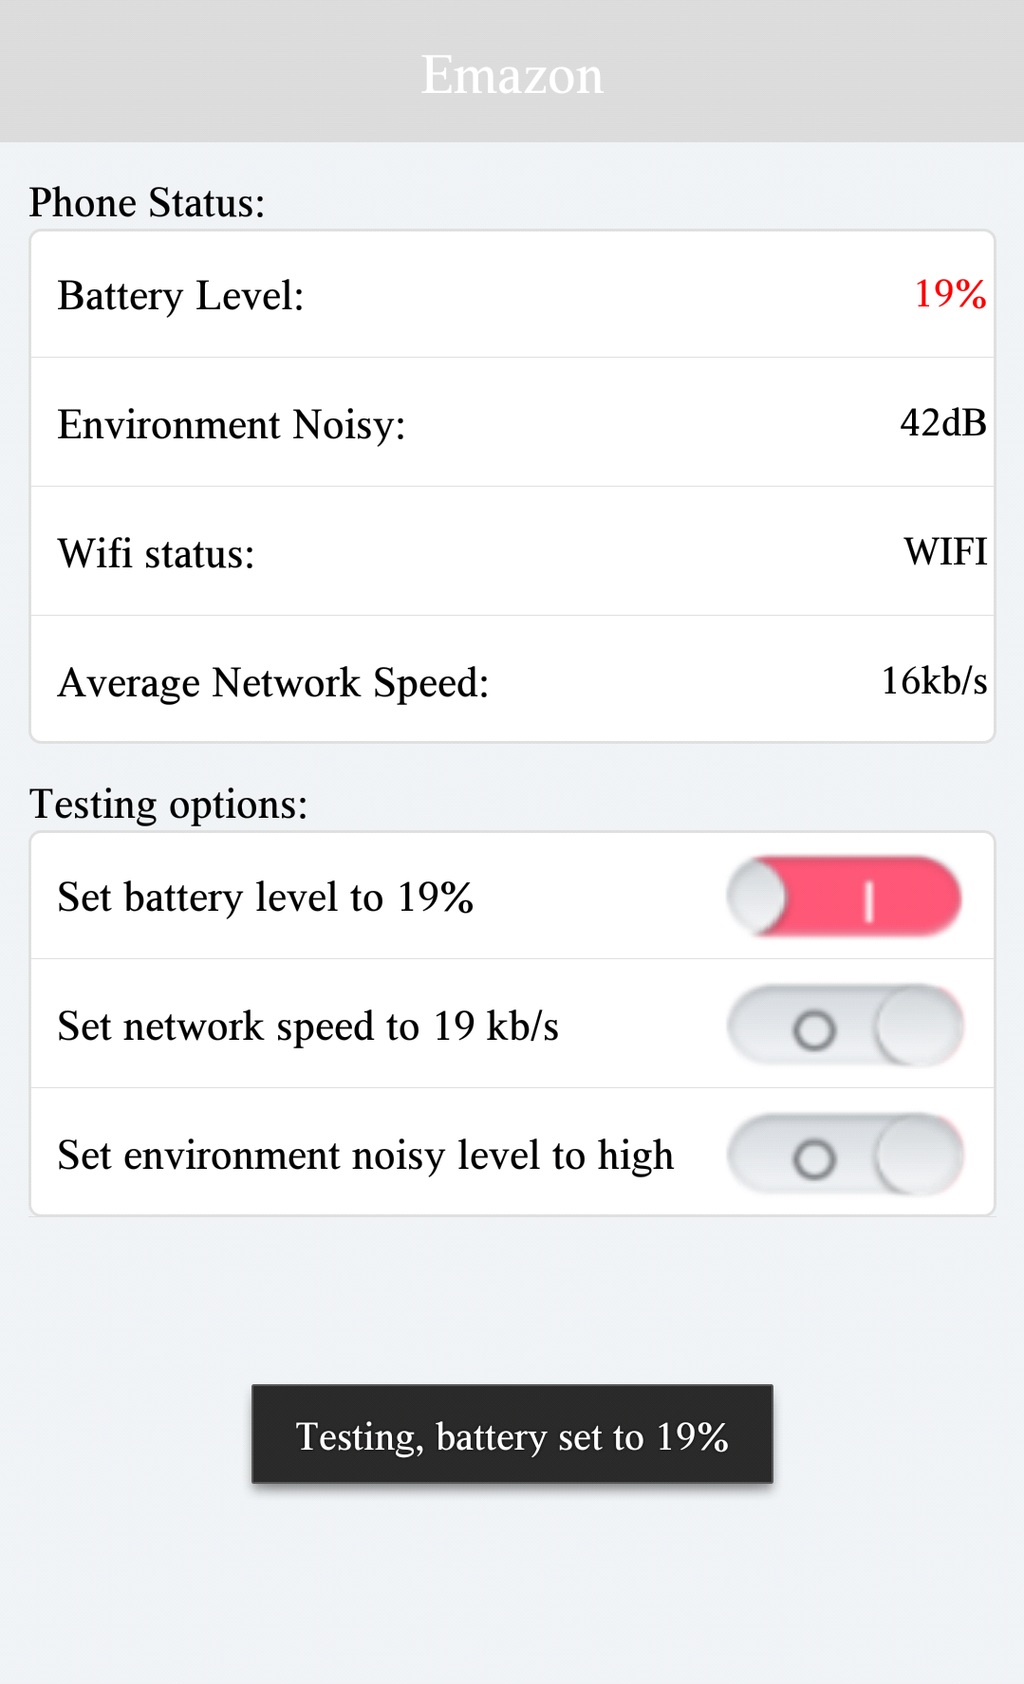
Setting, context setting, testing simulation

Slide 7
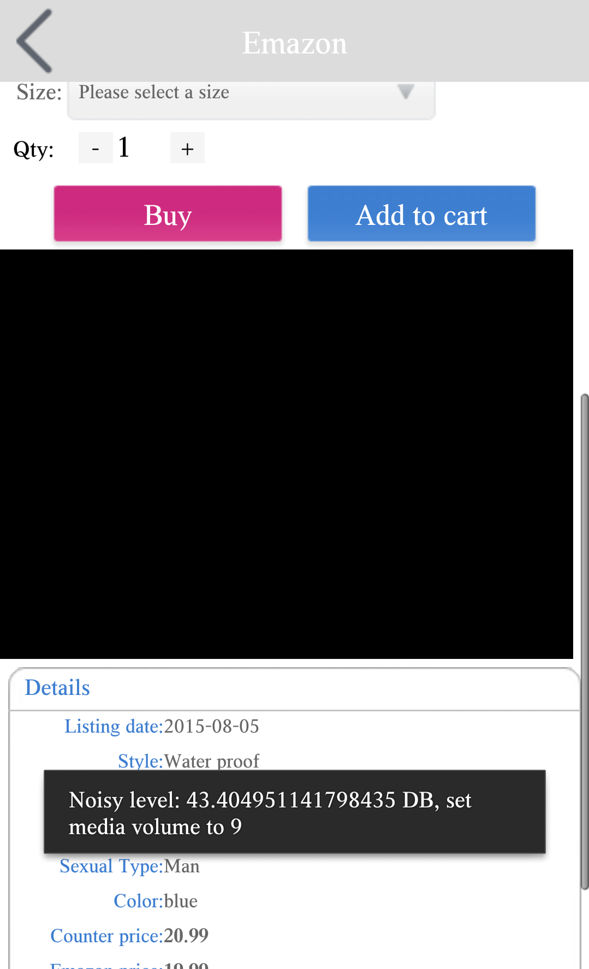
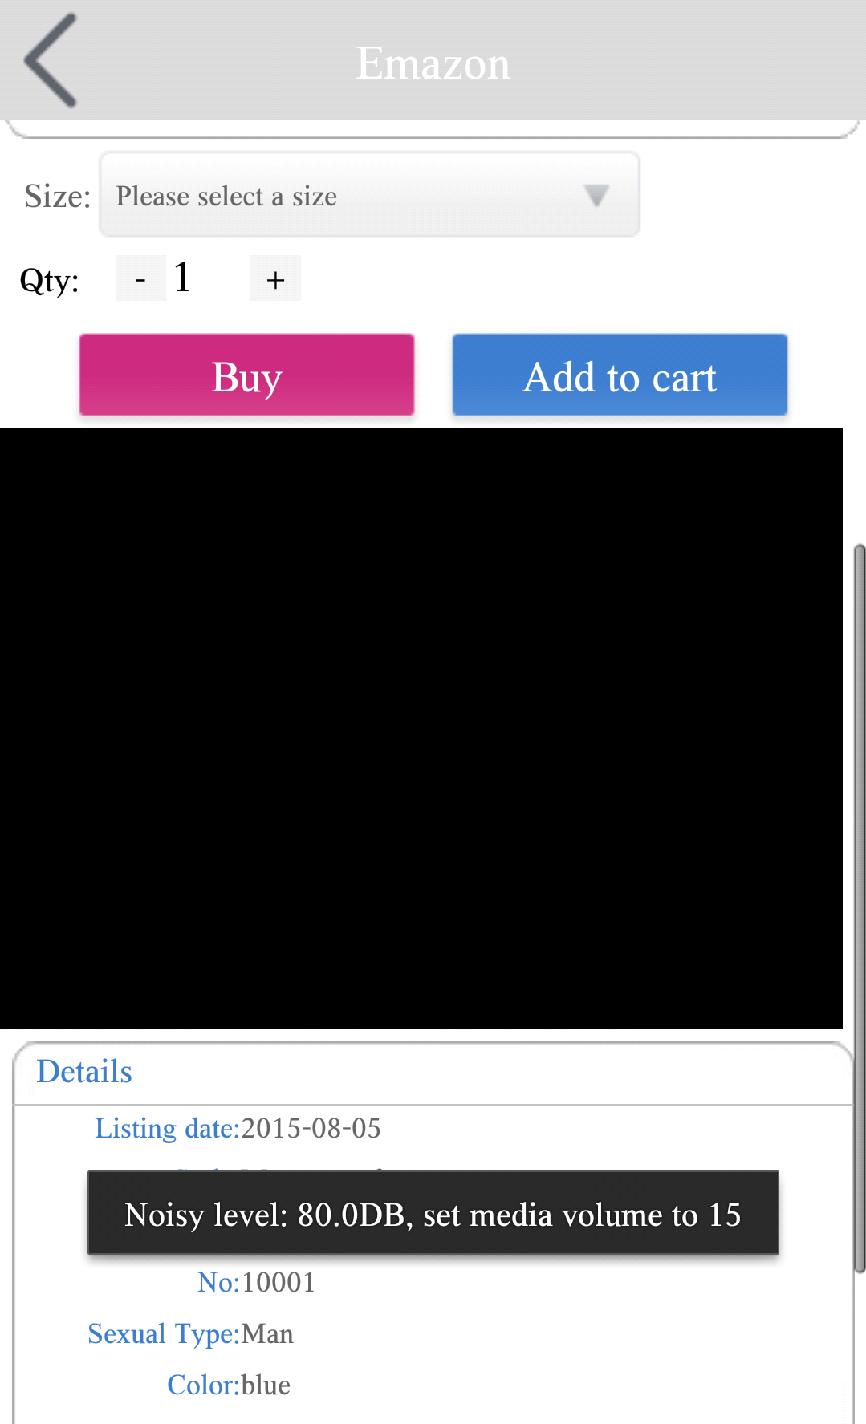
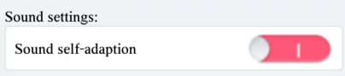
Sound self-adaption
If the sound self-adpation is enabled, like following
When environment noisy is high, adjust the media sound level automatically.
The picture shows the case, the noisy level is 42db, 80db respectively, and the media sound level is set to 10 (70% of maximum volue) and 15( maximum volume ) .
Notes:
15 max may differeciate with devices

Slide 8
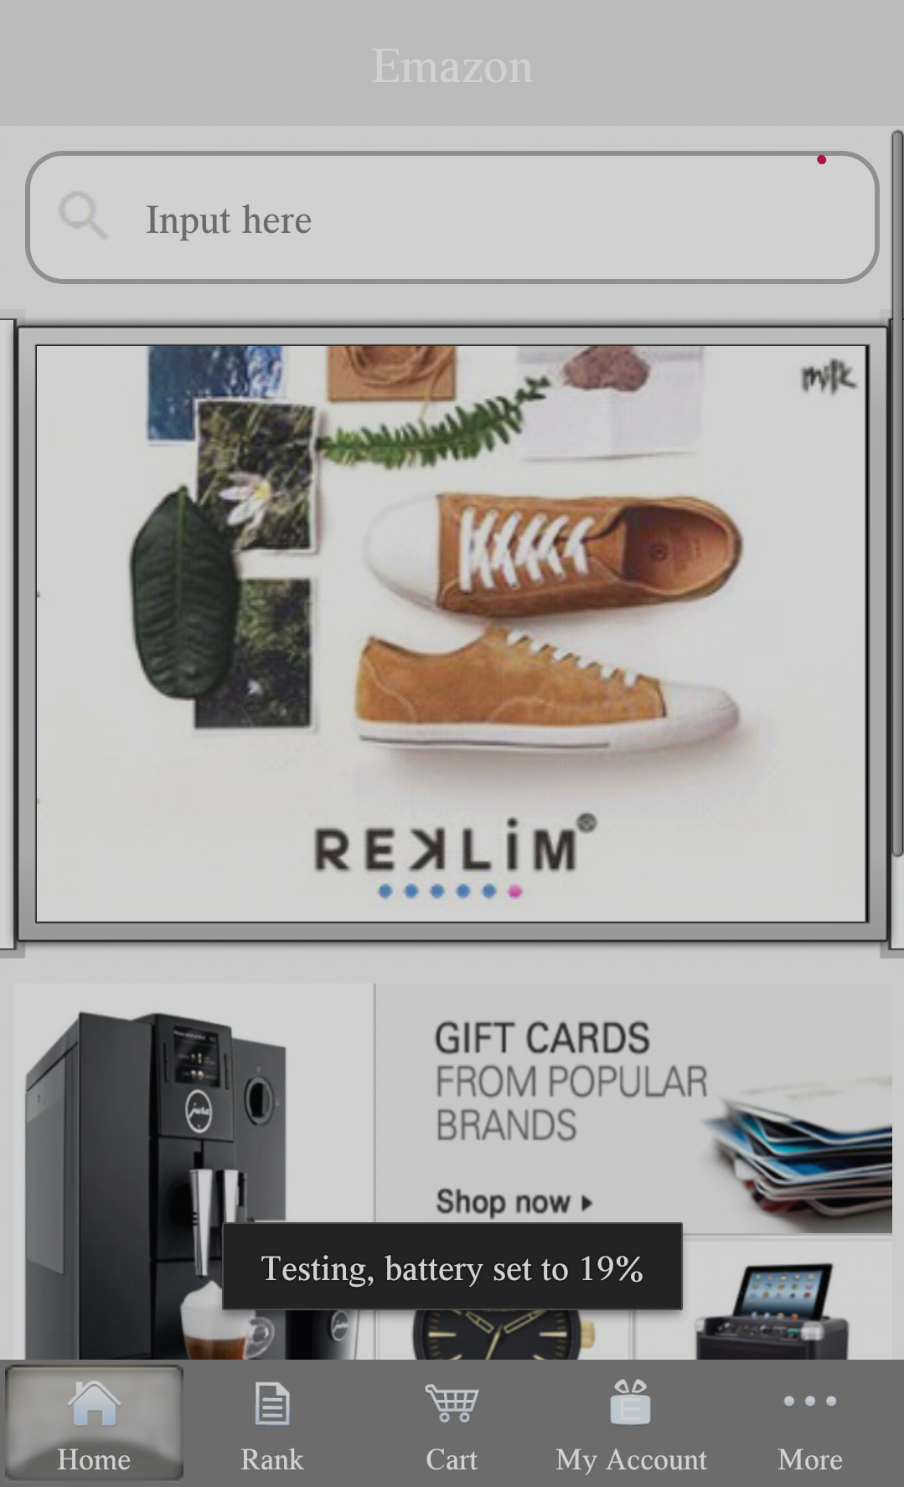
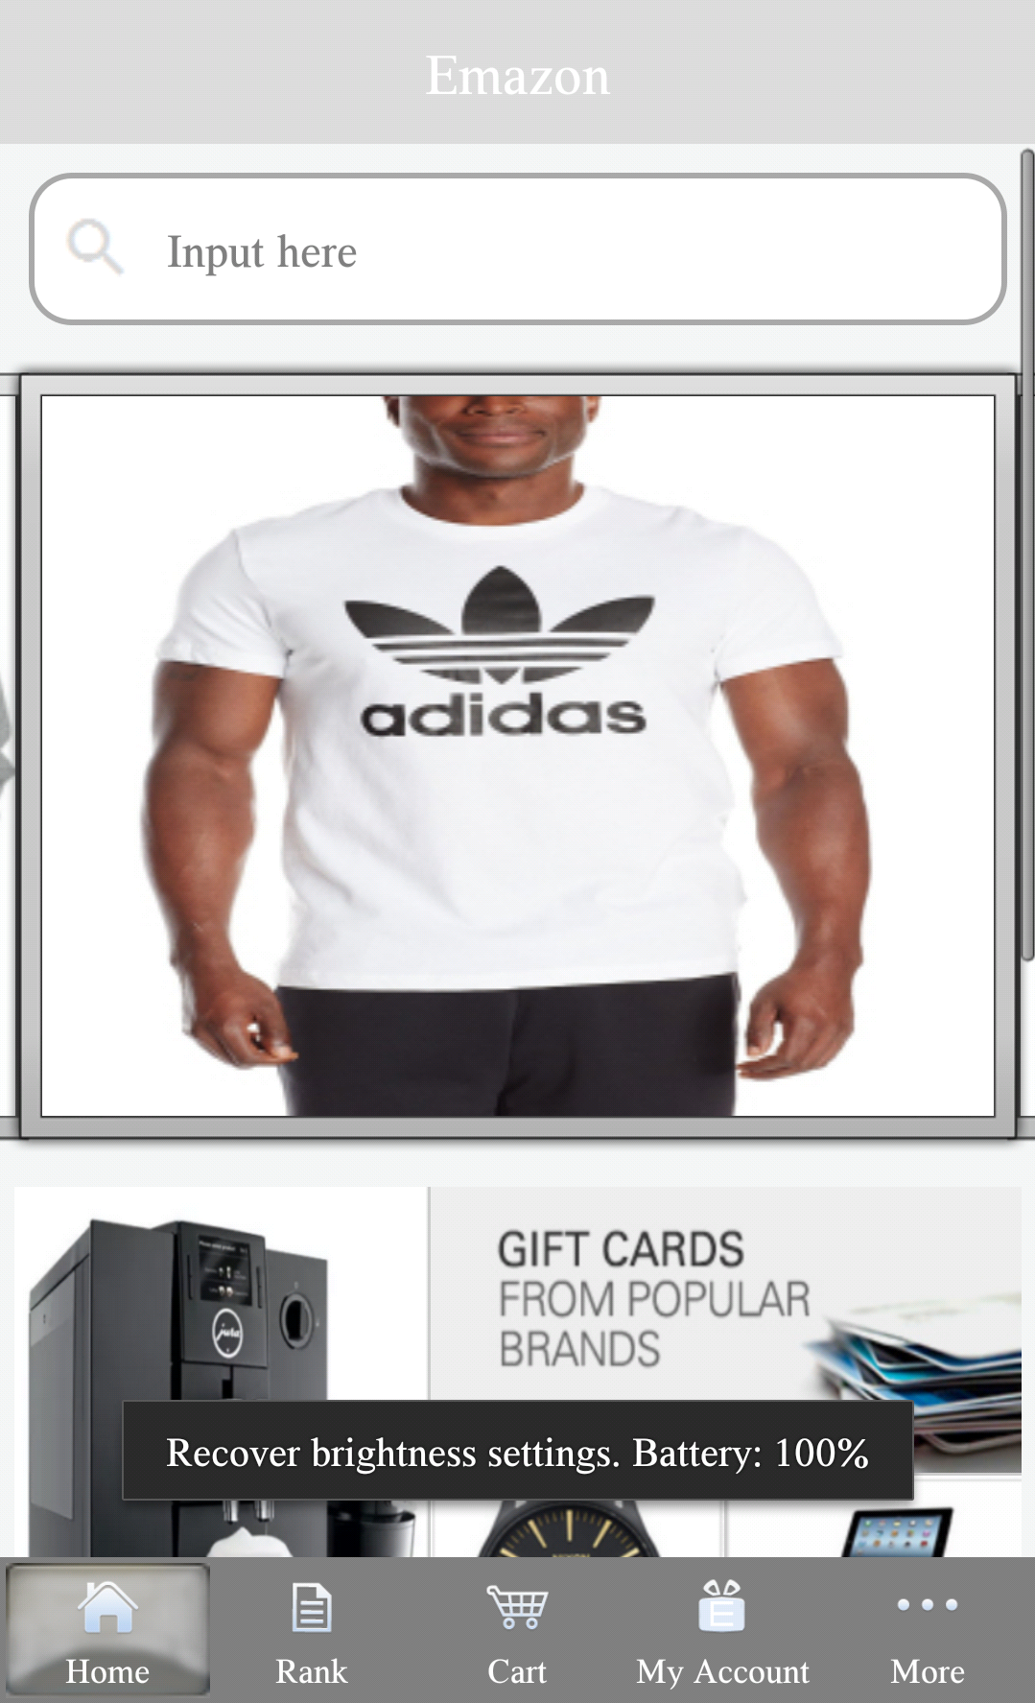
The brightness self-adaption is enabled when battery is less than 20%.
When battery level is low, the brightness will be automatically adjusted along with the environment brightness.
Once battery level is greater than 20%, the brightness setting will be reset to the original setting.
Notes:
tesing case-> tesing . 19%. battery 100% reset to original setting

Slide 9
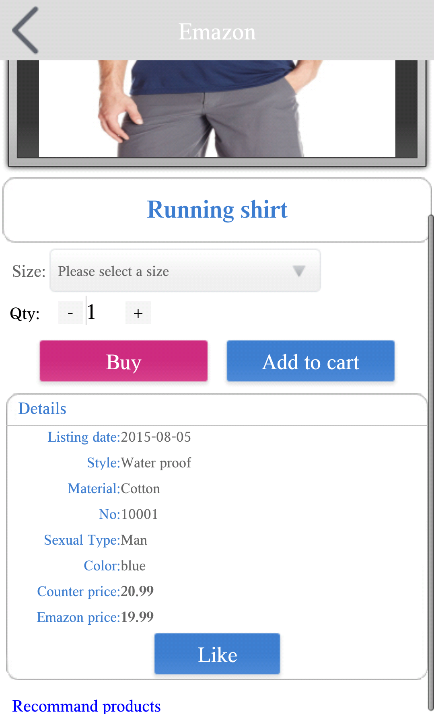
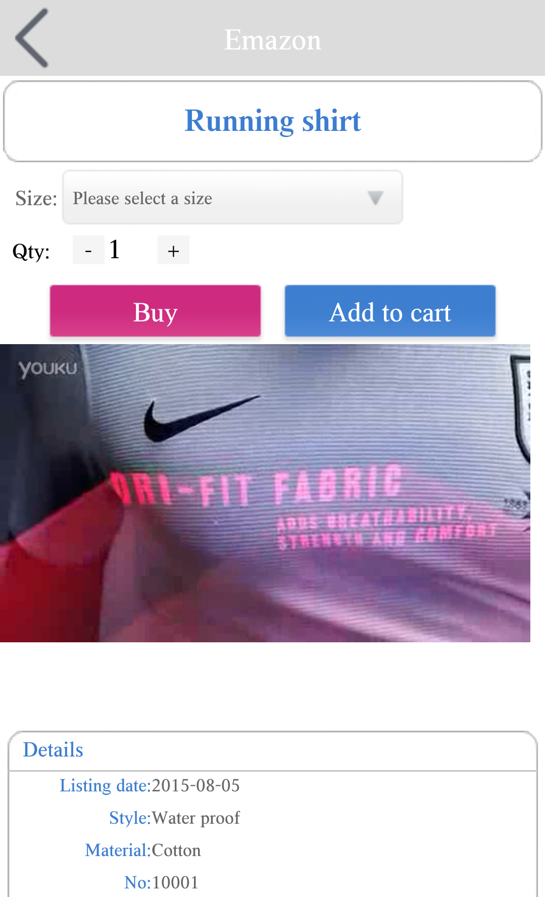
Video setting
Video is not present.
Video is present

Slide 10
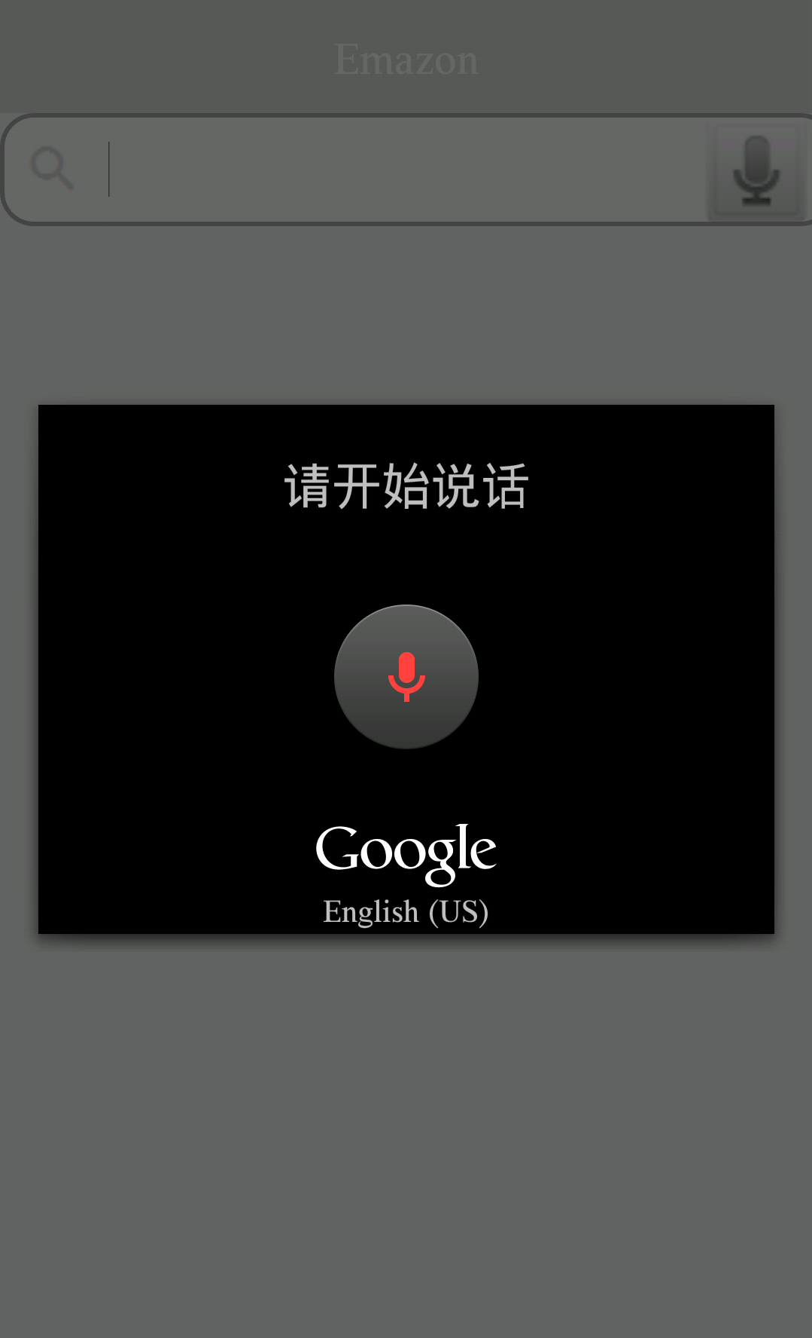
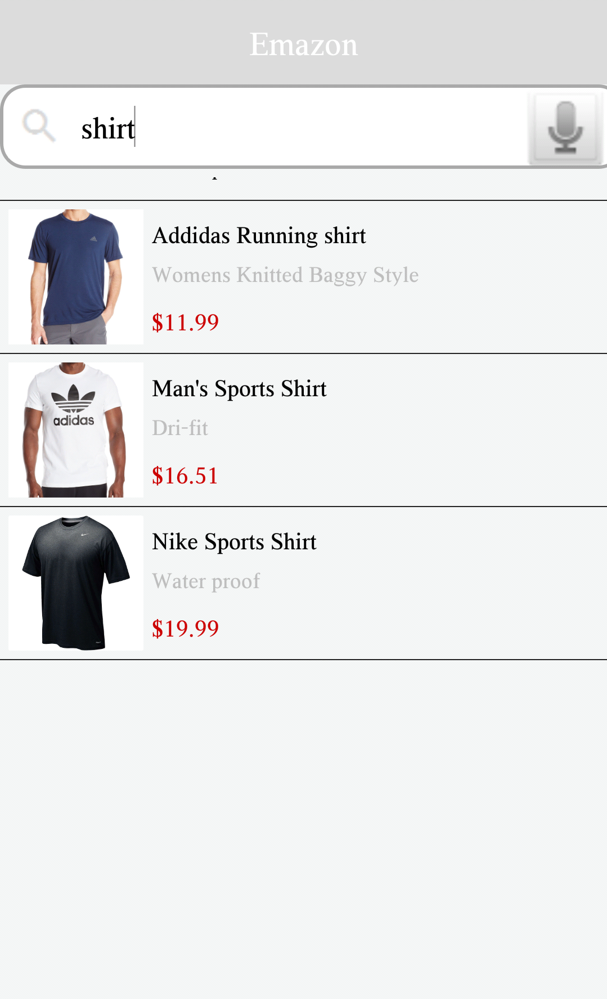
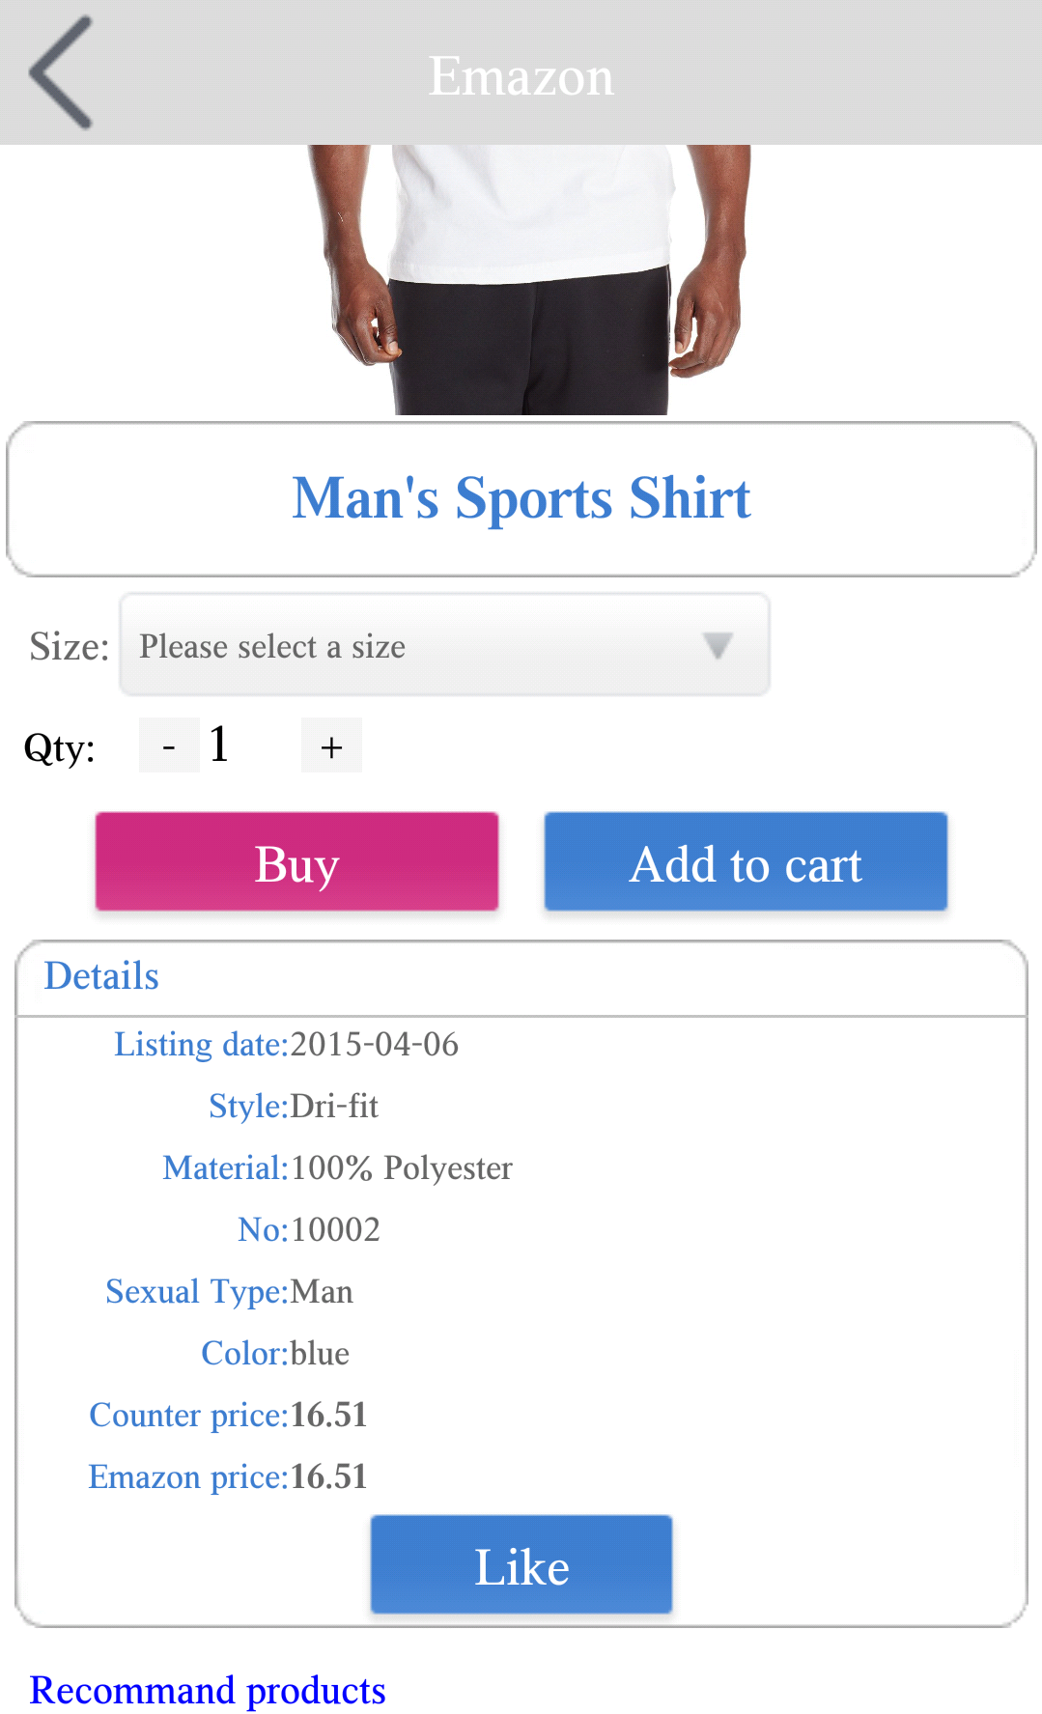
Scenario One ： VIP user use voice input to search a product

Slide 11
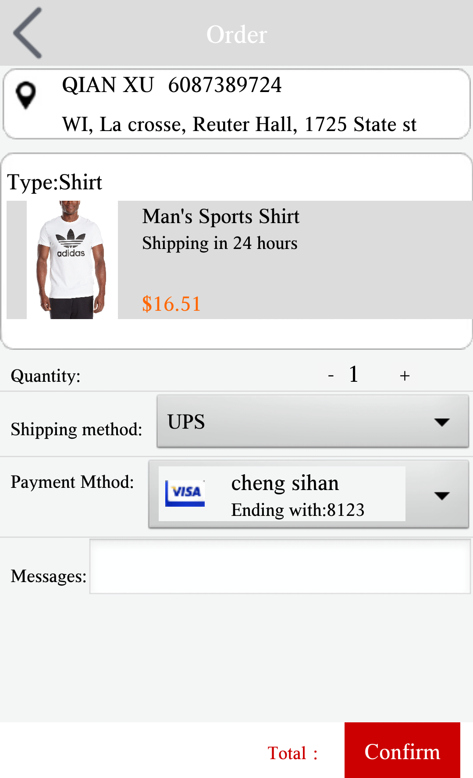
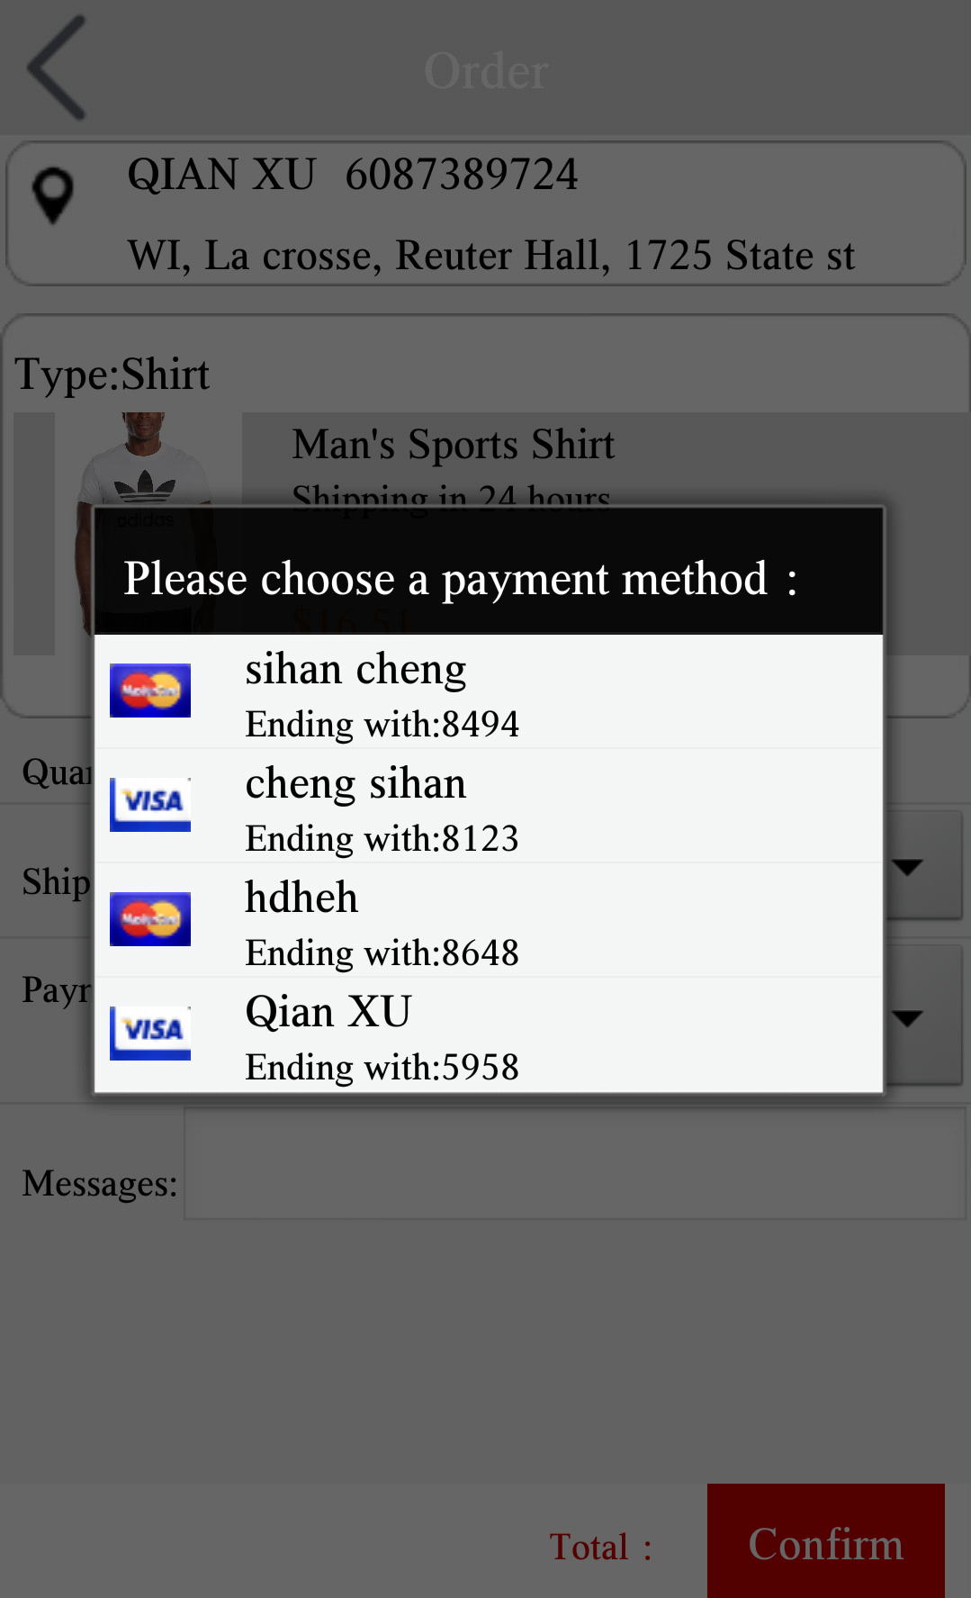
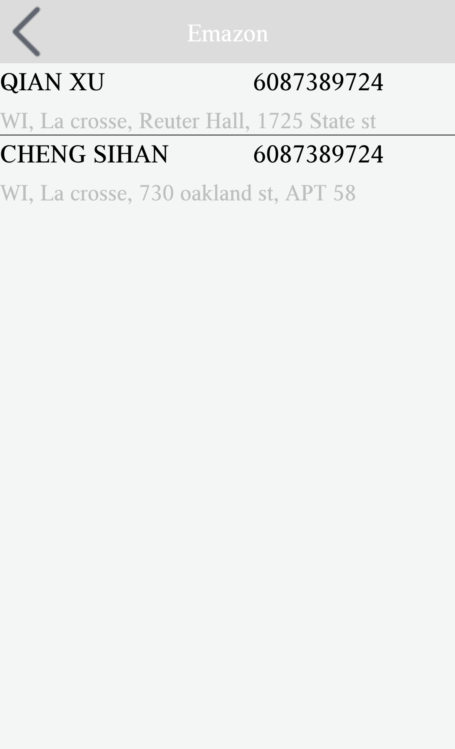
Continued
User can choose payment card and shipping address, what displays on the page is the defualt payment and shipping address which user can modify in personal profile(see next slide)

Slide 12
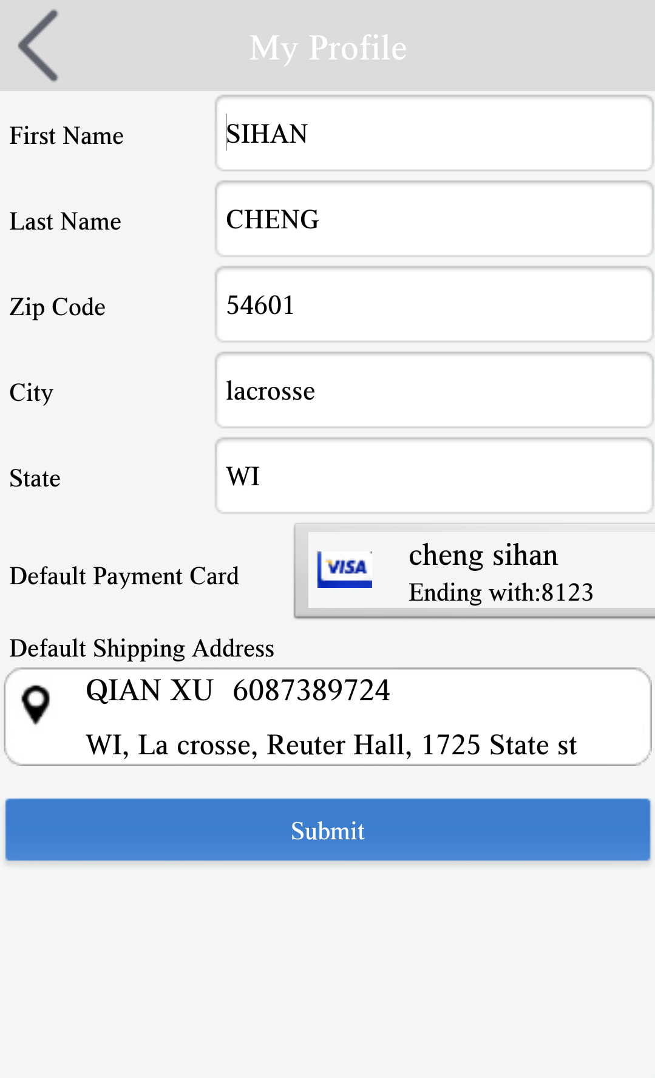
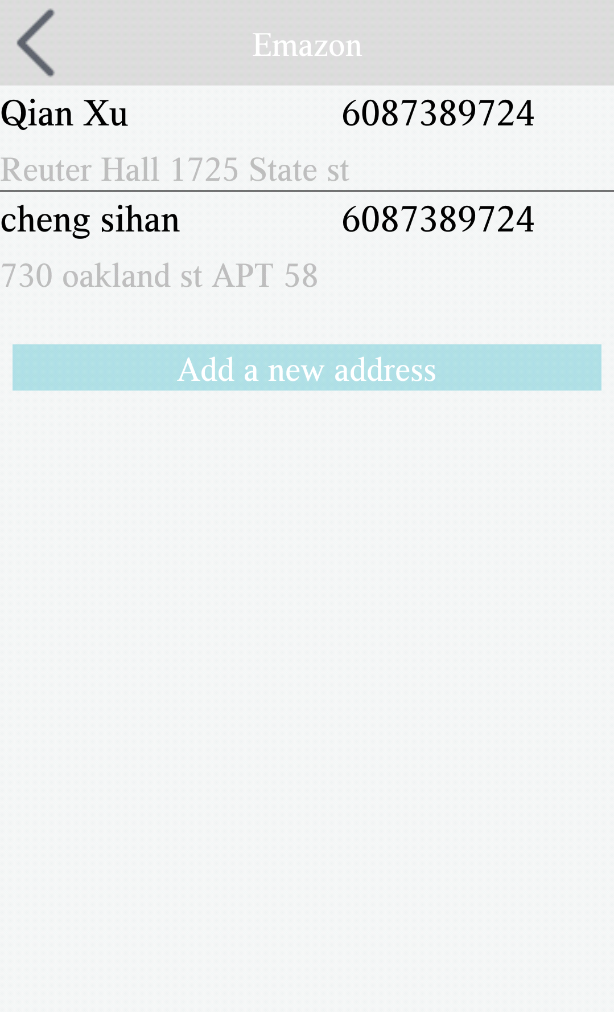
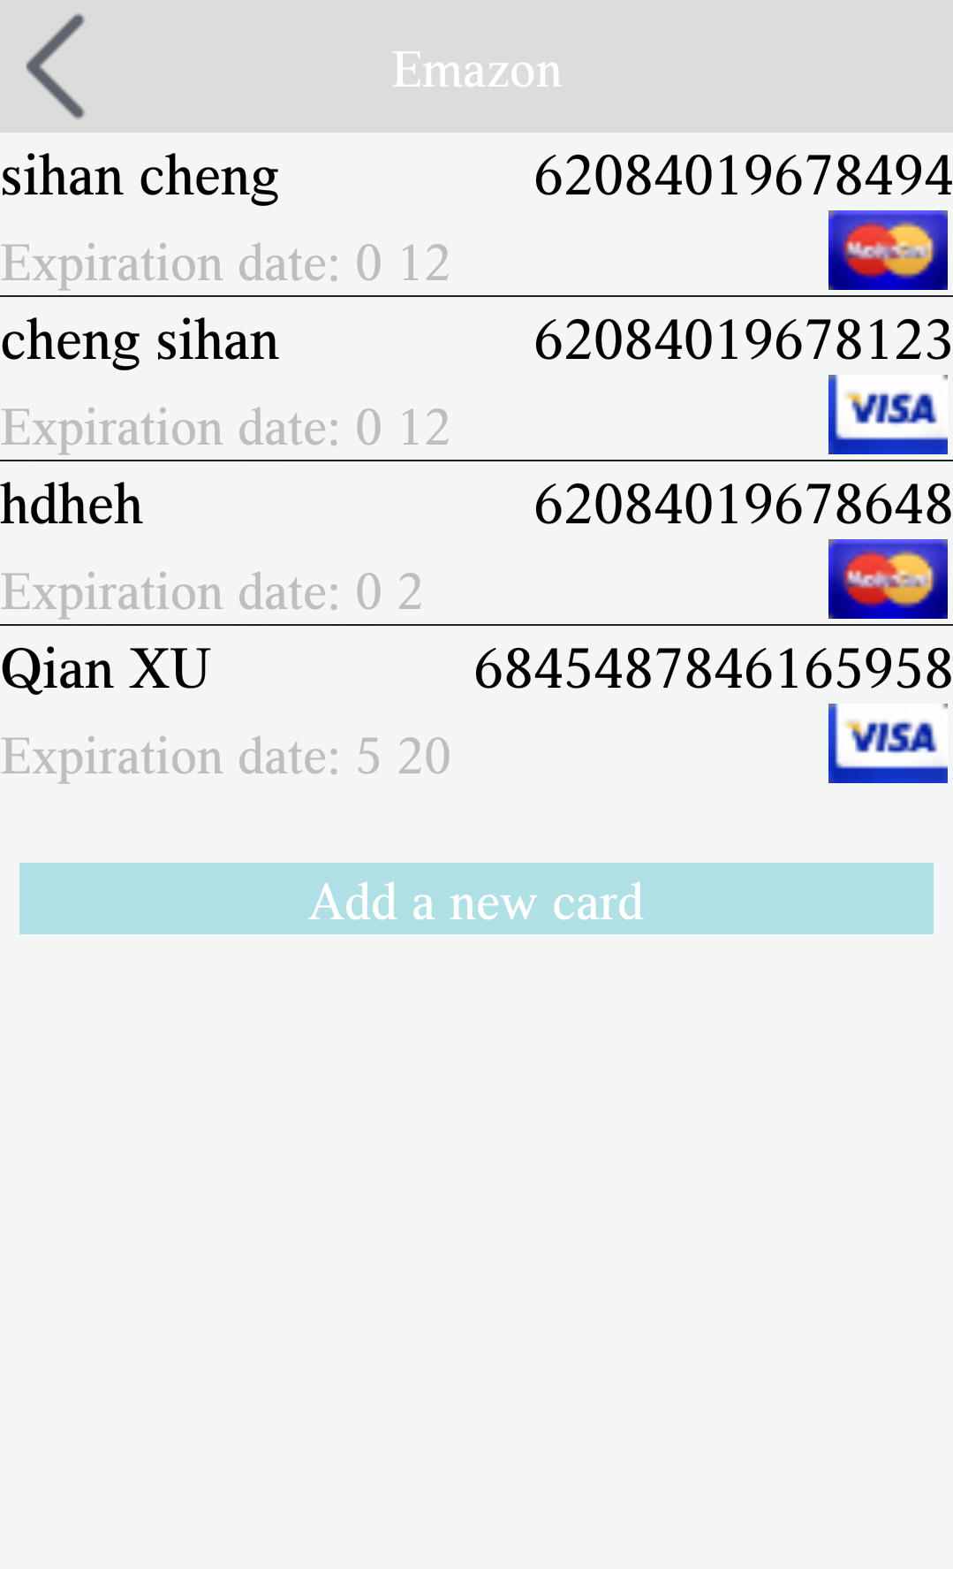
Continued
In the profile, user can change the default payment card default and shipping address. User also can add a new address and a new payment card in the My Account page.

Slide 13
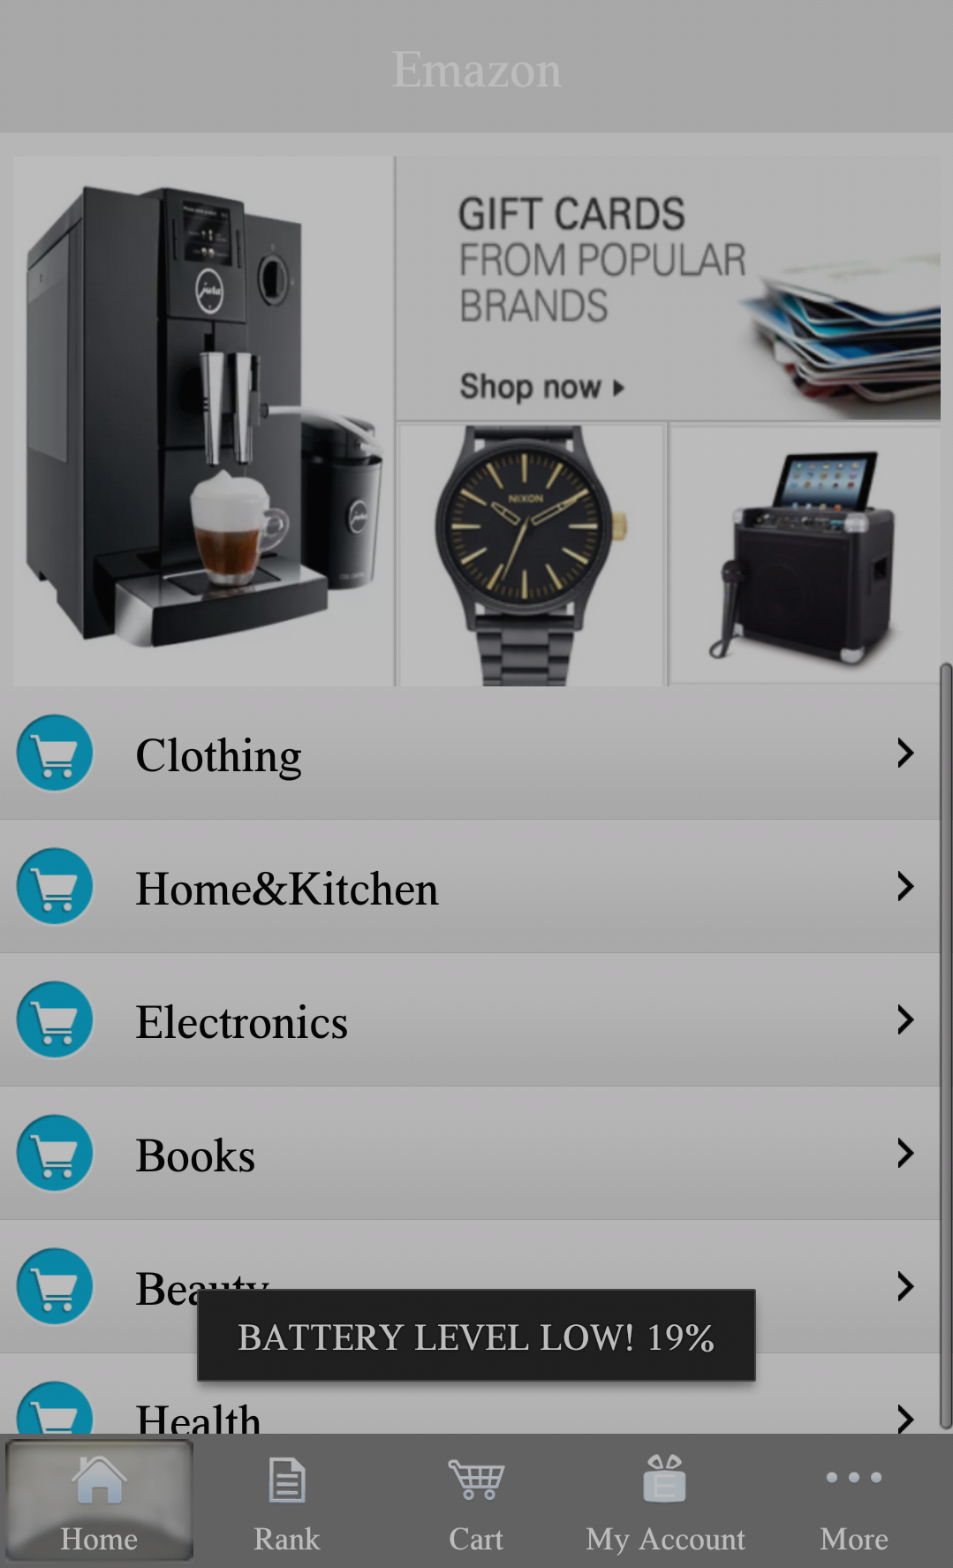
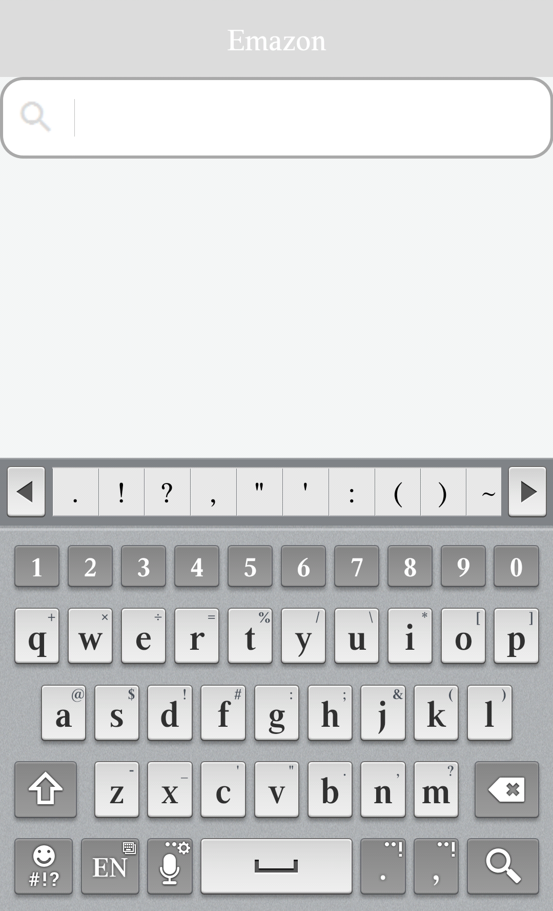
Continued
In low battery simulation, the video is not present and brightness will be automatically adjusted along with the environment brightness. The voice input is not allowed.

Slide 14
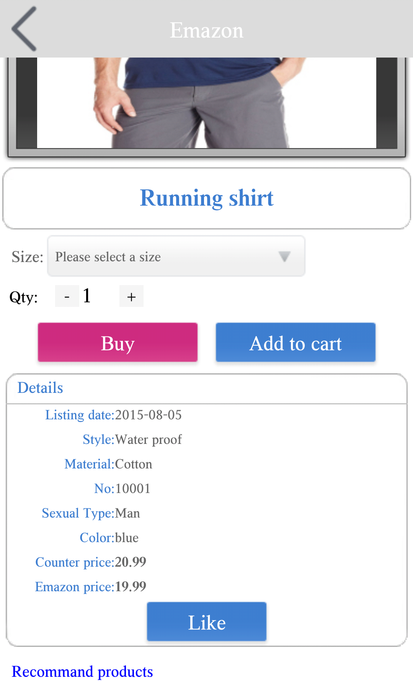
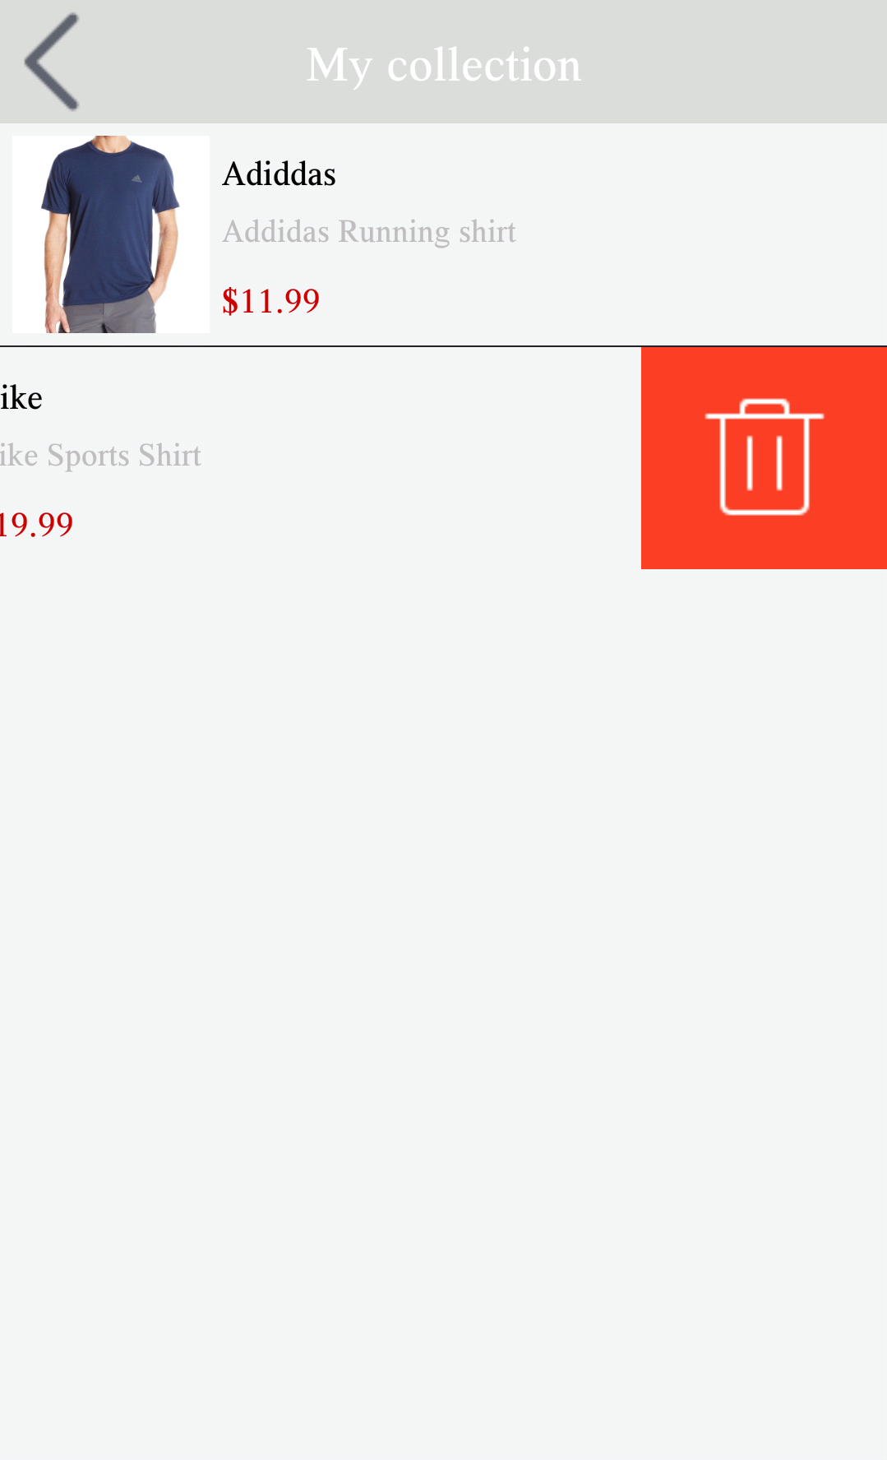
Continued
You can manage your collections simply by sliding to the left.
Video is not present
Use voice command to open My Order page, see the video

Slide 15
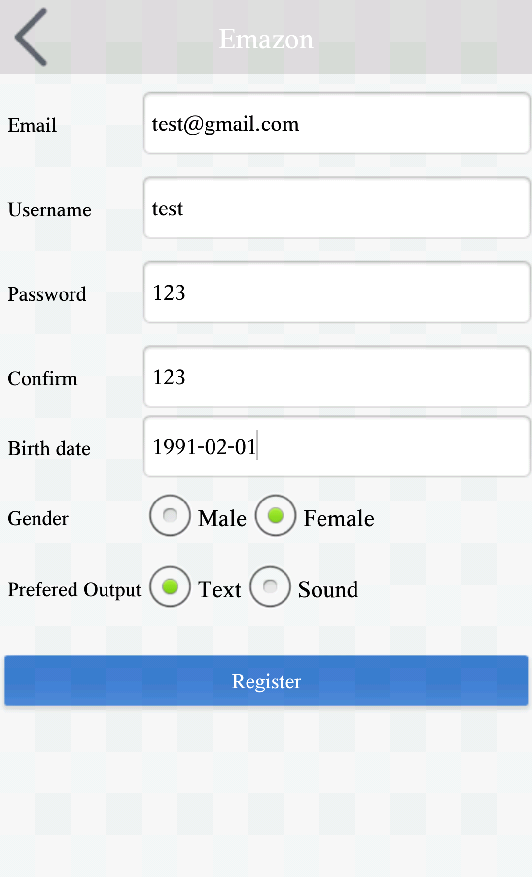
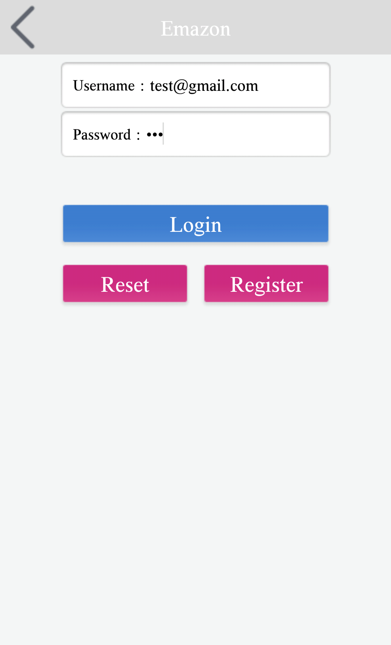
Scenario Two： New user registered and loggin with email
We choose female, and "Text" as prefered output
Login with email address

Slide 16
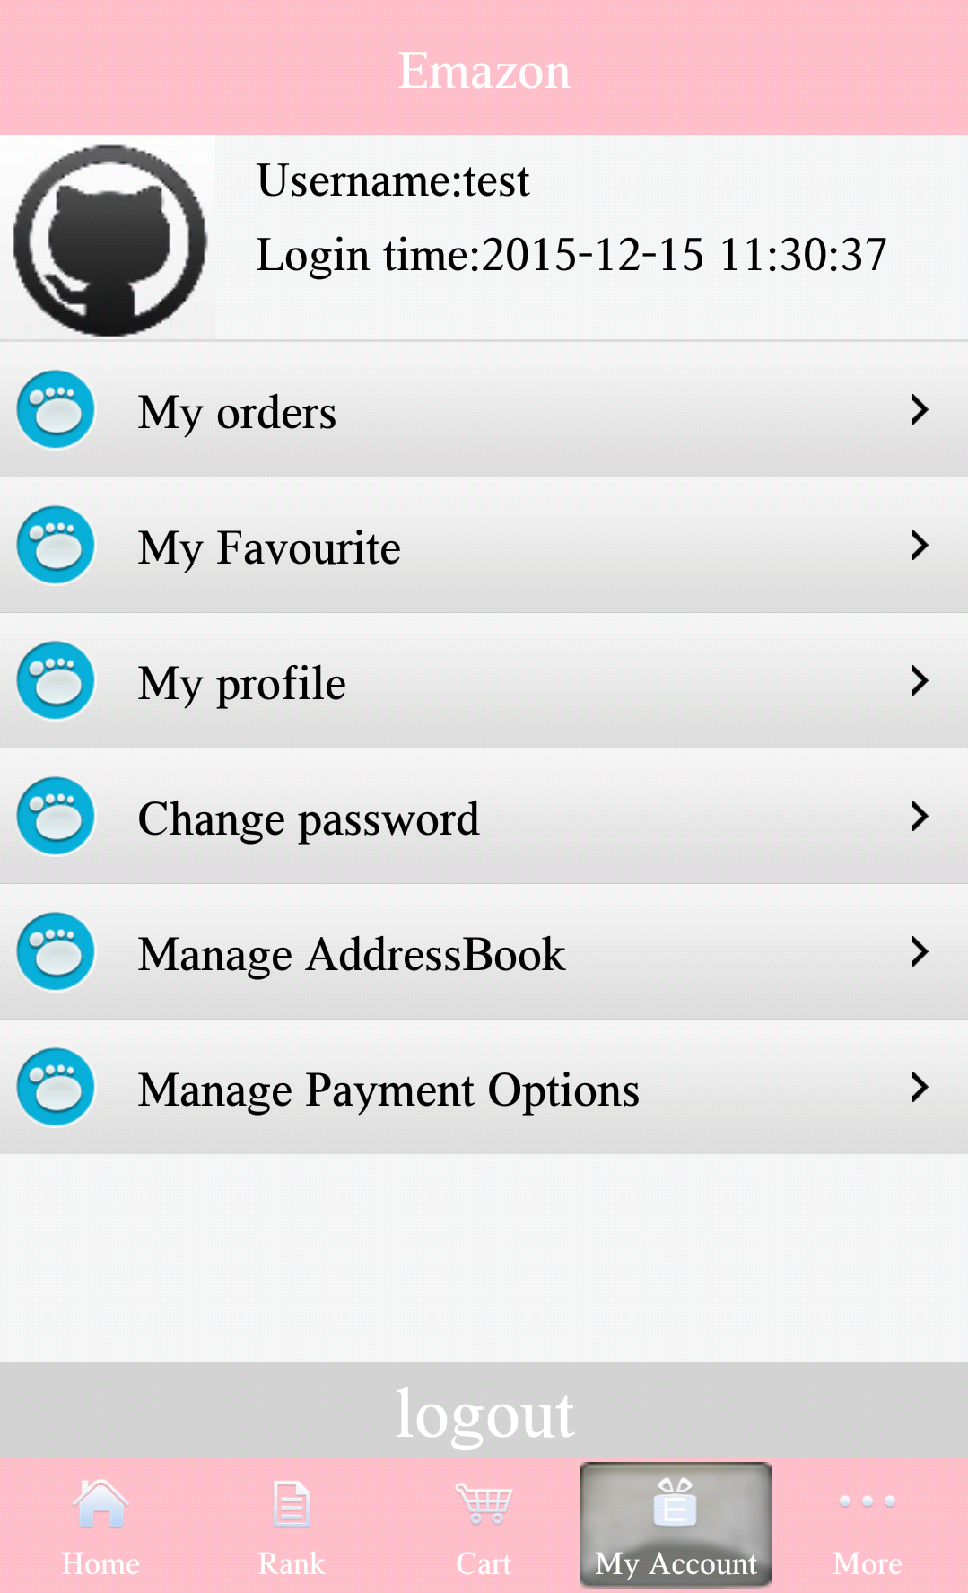
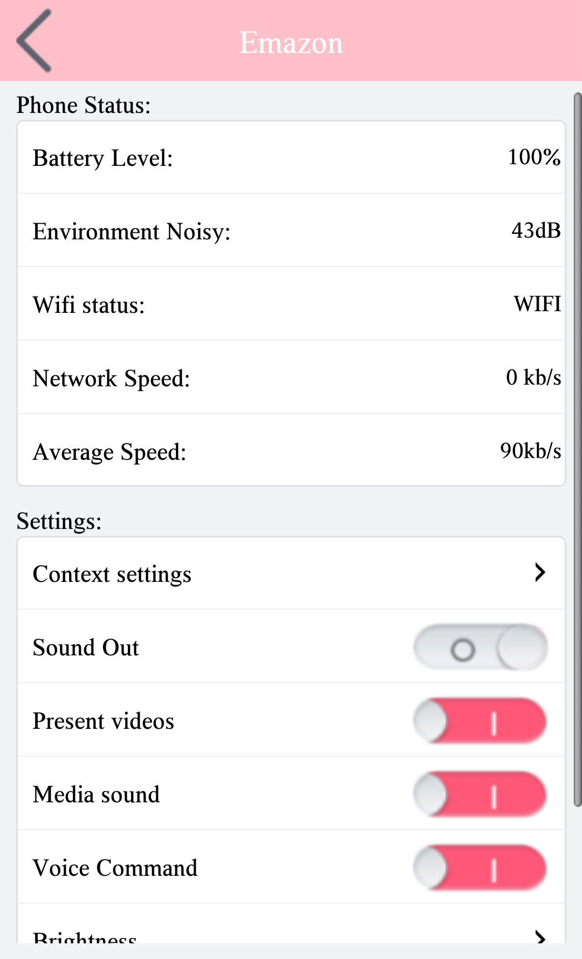
Continued
The theme changed to Female theme- pink automatically after loggin.
New user is Non VIP user
Sound out setting is turned off due to our choice for prefered output as text when register.

Slide 17
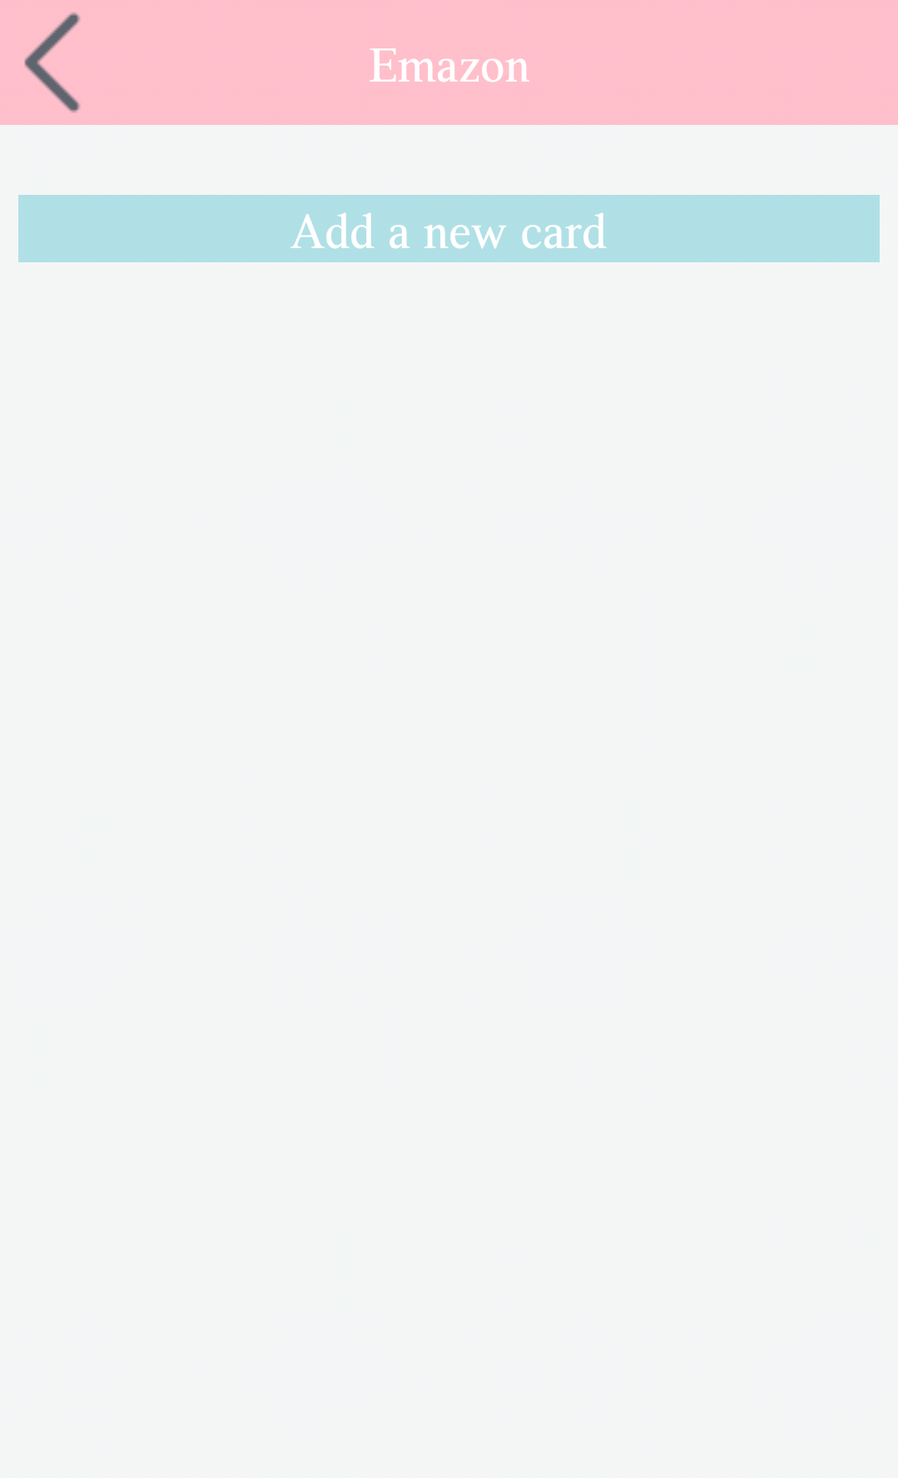
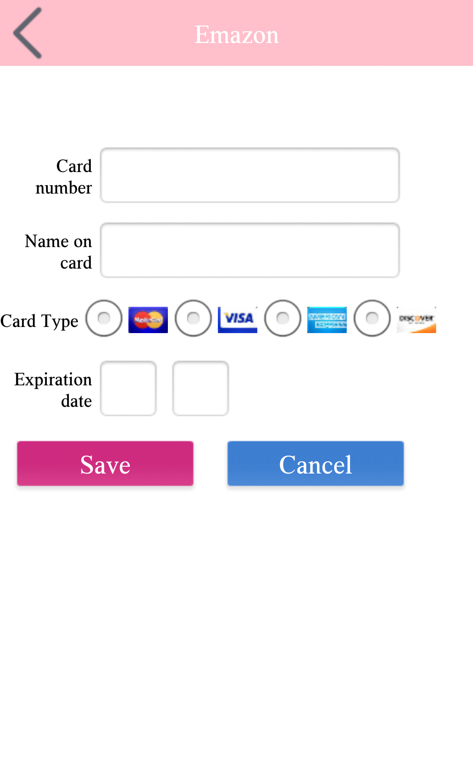
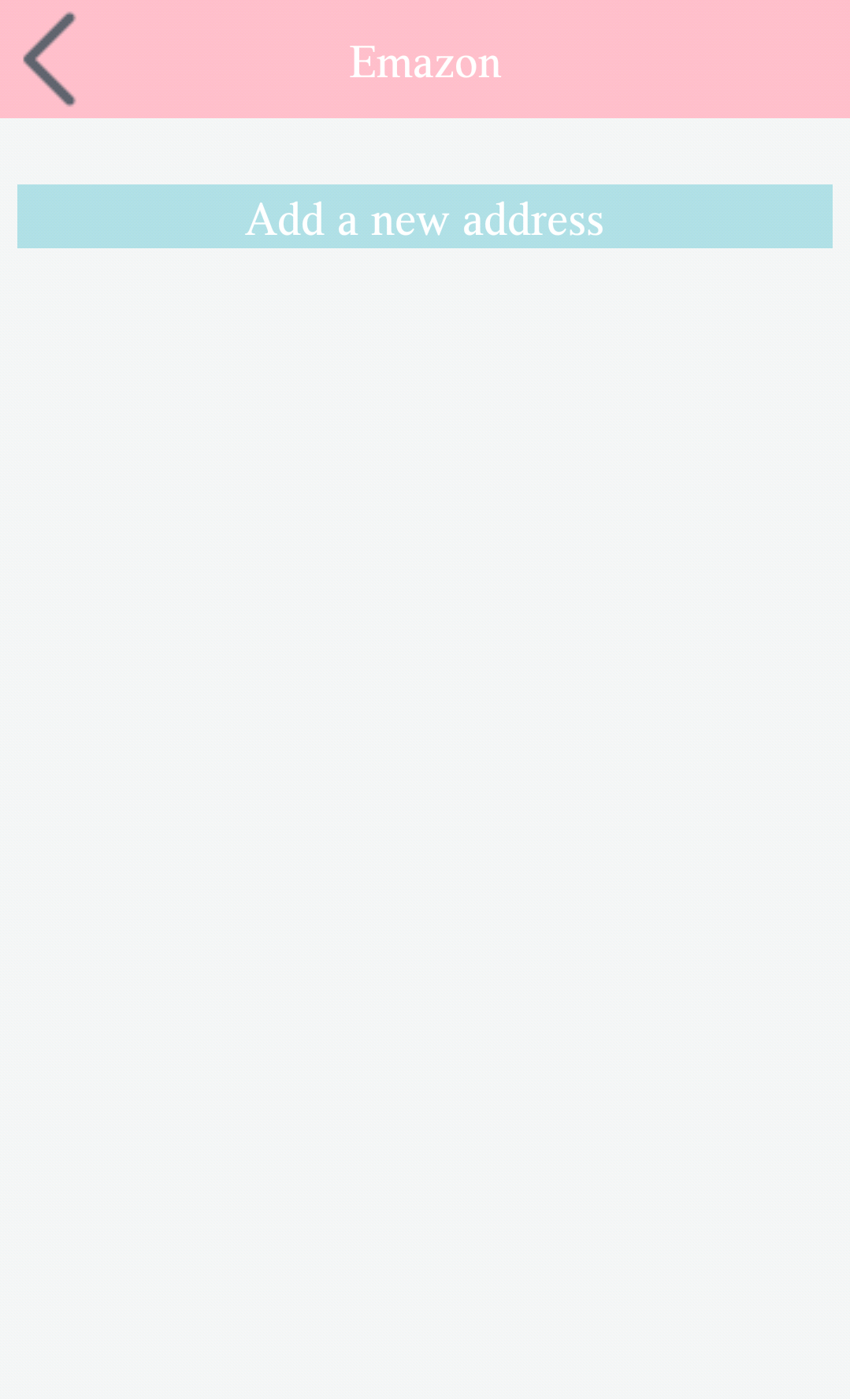
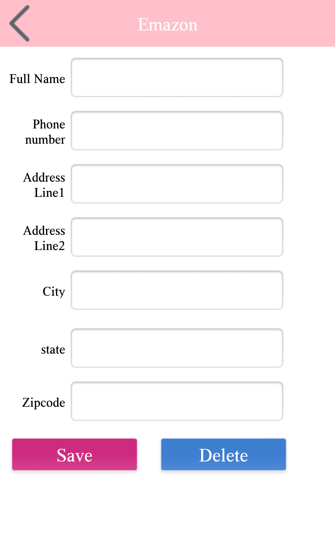
Continued
User can add new payment card and address information

